Slide 1
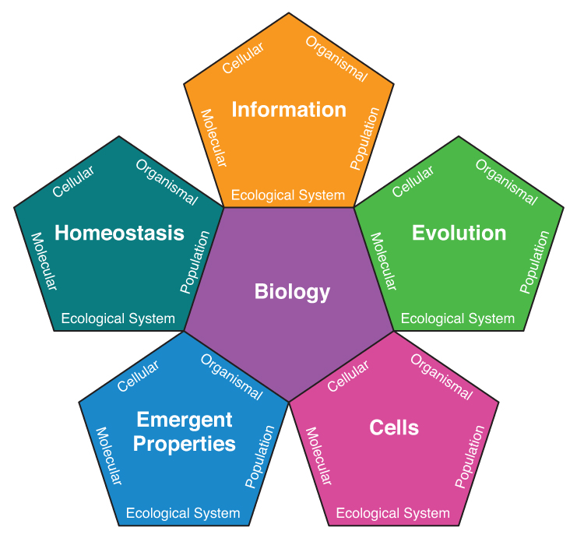
Integrating Concepts in Biology
PowerPoint Slides for Chapter 4:
Evolution and Origin of Cells
4.3 Can non-living objects compete and grow?
by A. Malcolm Campbell, Laurie J. Heyer, & Christopher Paradise
Copyright © 2015 by AM Campbell, LJ Heyer, CJ Paradise. All rights reserved.

Slide 2
Biology Learning Objectives
Illustrate how natural selection works by giving a real example.
Discuss how vesicles can grow and compete.
Illustrate how abiotic structures exhibit dynamic and competitive behaviors.
Bio-Math Learning Objectives
Determine the rate of change in a biological measurement
Copyright © 2015 by AM Campbell, LJ Heyer, CJ Paradise. All rights reserved.

Slide 3
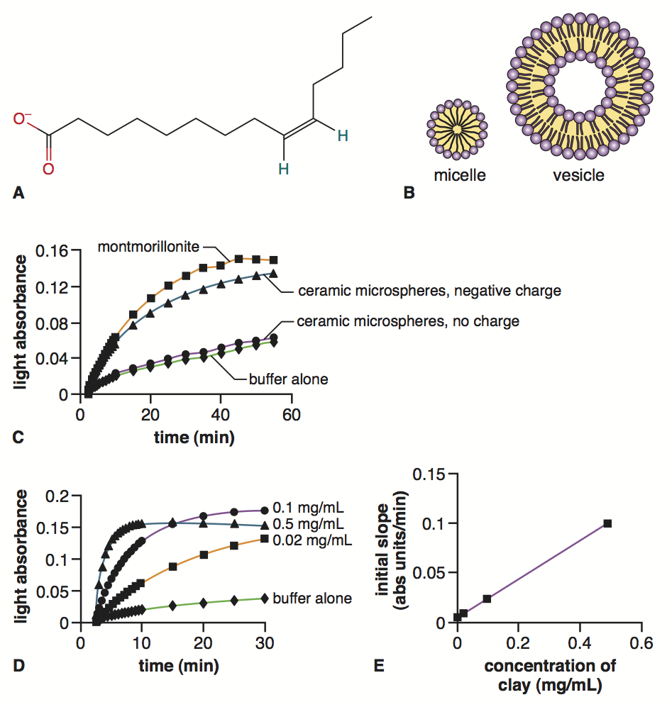
Fig. 4.11
Abiotic Vesicle Formation
C, D, E. modified from Hanczyc et al., 2003.
Copyright © 2015 by AM Campbell, LJ Heyer, CJ Paradise. All rights reserved.
Notes:
Figure 4.11 Fatty acid structures and vesicle formation rates. A, Myristoleate chemical structure. B, Fatty acid monolayer forming a micelle and a bilayer forming a membrane vesicle. C, Effects of different solid surfaces for vesicle formation. D, Effects of different concentrations of clay on vesicle formation. E, Initial rates of vesicle formation based on clay concentrations.
Talking point: First experiment to determine how lipid vesicles could form abiotically in nature.

Slide 4
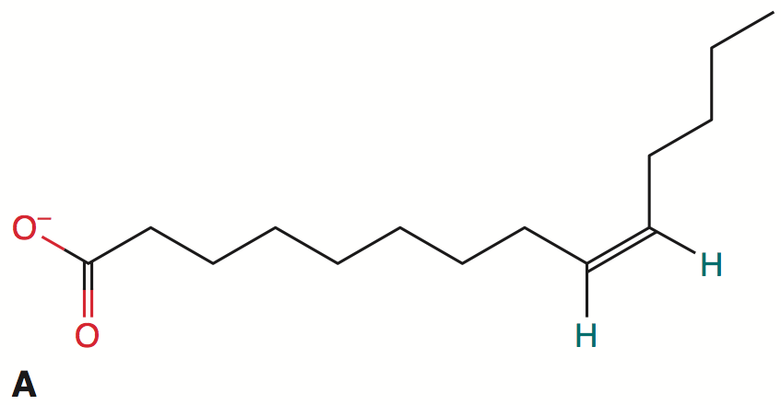
Fig. 4.11
Naturally Occurring Lipid
myristoleate fatty acid
hydrophilic
hydrophobic
C, D, E. modified from Hanczyc et al., 2003.
Copyright © 2015 by AM Campbell, LJ Heyer, CJ Paradise. All rights reserved.
Notes:
Figure 4.11 Fatty acid structures and vesicle formation rates. A, Myristoleate chemical structure. B, Fatty acid monolayer forming a micelle and a bilayer forming a membrane vesicle. C, Effects of different solid surfaces for vesicle formation. D, Effects of different concentrations of clay on vesicle formation. E, Initial rates of vesicle formation based on clay concentrations.
Talking point: Typical fatty acid with hydrophobic tail and hydrophylic head group.

Slide 5
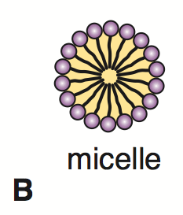
Fig. 4.11
Single Layer Sphere of Lipids
C, D, E. modified from Hanczyc et al., 2003.
Copyright © 2015 by AM Campbell, LJ Heyer, CJ Paradise. All rights reserved.
Notes:
Figure 4.11 Fatty acid structures and vesicle formation rates. A, Myristoleate chemical structure. B, Fatty acid monolayer forming a micelle and a bilayer forming a membrane vesicle. C, Effects of different solid surfaces for vesicle formation. D, Effects of different concentrations of clay on vesicle formation. E, Initial rates of vesicle formation based on clay concentrations.
Talking point: Single-layered lipid structure with no central cavity, or lumen.

Slide 6
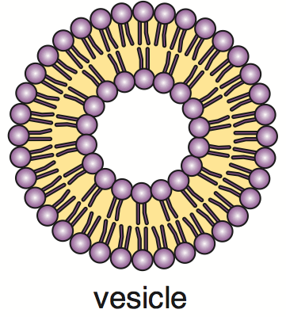
Fig. 4.11
Lipid Bilayer Hollow Vesicle
C, D, E. modified from Hanczyc et al., 2003.
Copyright © 2015 by AM Campbell, LJ Heyer, CJ Paradise. All rights reserved.
Notes:
Figure 4.11 Fatty acid structures and vesicle formation rates. A, Myristoleate chemical structure. B, Fatty acid monolayer forming a micelle and a bilayer forming a membrane vesicle. C, Effects of different solid surfaces for vesicle formation. D, Effects of different concentrations of clay on vesicle formation. E, Initial rates of vesicle formation based on clay concentrations.
Talking point: Two fatty acids in the lipid bilayer. Central lumen present in vesicle.

Slide 7
Fig. 4.11
Lipid Bilayer Hollow Vesicle
view
Jsmol membrane
C, D, E. modified from Hanczyc et al., 2003.
Copyright © 2015 by AM Campbell, LJ Heyer, CJ Paradise. All rights reserved.
Notes:
Figure 4.11 Fatty acid structures and vesicle formation rates. A, Myristoleate chemical structure. B, Fatty acid monolayer forming a micelle and a bilayer forming a membrane vesicle. C, Effects of different solid surfaces for vesicle formation. D, Effects of different concentrations of clay on vesicle formation. E, Initial rates of vesicle formation based on clay concentrations.
Talking point: Students can interact with Jsmol membrane to get a sense for how far water can penetrate a lipid bilayer.
http://biomodel.uah.es/en/model3js/bicapa.htm

Slide 8
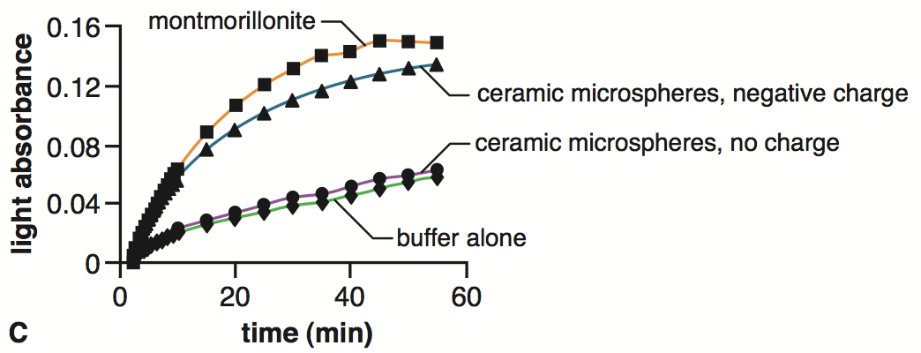
Fig. 4.11
Unable to form Vesicles Quickly
measure of
vesicle formation
negative controls
C, D, E. modified from Hanczyc et al., 2003.
Copyright © 2015 by AM Campbell, LJ Heyer, CJ Paradise. All rights reserved.
Notes:
Figure 4.11 Fatty acid structures and vesicle formation rates. A, Myristoleate chemical structure. B, Fatty acid monolayer forming a micelle and a bilayer forming a membrane vesicle. C, Effects of different solid surfaces for vesicle formation. D, Effects of different concentrations of clay on vesicle formation. E, Initial rates of vesicle formation based on clay concentrations.
Talking point: Fatty acids do not form vesicles when mixed with buffer alone, or buffer plus uncharged microspheres.

Slide 9
Fig. 4.11
Catalytic Charged Surfaces
measure of
vesicle formation
two solid catalysts
C, D, E. modified from Hanczyc et al., 2003.
Copyright © 2015 by AM Campbell, LJ Heyer, CJ Paradise. All rights reserved.
Notes:
Figure 4.11 Fatty acid structures and vesicle formation rates. A, Myristoleate chemical structure. B, Fatty acid monolayer forming a micelle and a bilayer forming a membrane vesicle. C, Effects of different solid surfaces for vesicle formation. D, Effects of different concentrations of clay on vesicle formation. E, Initial rates of vesicle formation based on clay concentrations.
Talking point: Charged microspheres and natural clay both catalyze vesicle formation.

Slide 10
Fig. 4.11
Catalytic Charged Surfaces
C, D, E. modified from Hanczyc et al., 2003.
Copyright © 2015 by AM Campbell, LJ Heyer, CJ Paradise. All rights reserved.
Notes:
Figure 4.11 Fatty acid structures and vesicle formation rates. A, Myristoleate chemical structure. B, Fatty acid monolayer forming a micelle and a bilayer forming a membrane vesicle. C, Effects of different solid surfaces for vesicle formation. D, Effects of different concentrations of clay on vesicle formation. E, Initial rates of vesicle formation based on clay concentrations.
Talking point: Comparison to negative controls.

Slide 11
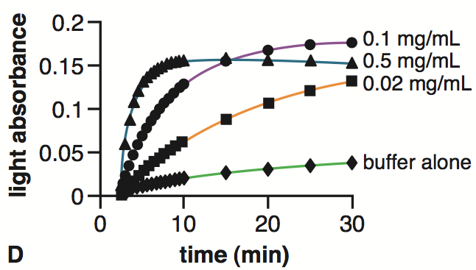
Fig. 4.11
Clay Concentration Effects
measure of
vesicle formation
C, D, E. modified from Hanczyc et al., 2003.
Copyright © 2015 by AM Campbell, LJ Heyer, CJ Paradise. All rights reserved.
Notes:
Figure 4.11 Fatty acid structures and vesicle formation rates. A, Myristoleate chemical structure. B, Fatty acid monolayer forming a micelle and a bilayer forming a membrane vesicle. C, Effects of different solid surfaces for vesicle formation. D, Effects of different concentrations of clay on vesicle formation. E, Initial rates of vesicle formation based on clay concentrations.
Talking point: Negative control worked as expected.

Slide 12
Fig. 4.11
Clay Concentration Effects
measure of
vesicle formation
negative control
C, D, E. modified from Hanczyc et al., 2003.
Copyright © 2015 by AM Campbell, LJ Heyer, CJ Paradise. All rights reserved.
Notes:
Figure 4.11 Fatty acid structures and vesicle formation rates. A, Myristoleate chemical structure. B, Fatty acid monolayer forming a micelle and a bilayer forming a membrane vesicle. C, Effects of different solid surfaces for vesicle formation. D, Effects of different concentrations of clay on vesicle formation. E, Initial rates of vesicle formation based on clay concentrations.
Talking point: Negative control worked as expected.

Slide 13
Fig. 4.11
Clay Concentration Effects
measure of
vesicle formation
lowest
concentration
C, D, E. modified from Hanczyc et al., 2003.
Copyright © 2015 by AM Campbell, LJ Heyer, CJ Paradise. All rights reserved.
Notes:
Figure 4.11 Fatty acid structures and vesicle formation rates. A, Myristoleate chemical structure. B, Fatty acid monolayer forming a micelle and a bilayer forming a membrane vesicle. C, Effects of different solid surfaces for vesicle formation. D, Effects of different concentrations of clay on vesicle formation. E, Initial rates of vesicle formation based on clay concentrations.
Talking point: Lowest concentration of natural clay was better than negative control (note initial slope).

Slide 14
Fig. 4.11
Clay Concentration Effects
measure of
vesicle formation
5X lowest concentration
C, D, E. modified from Hanczyc et al., 2003.
Copyright © 2015 by AM Campbell, LJ Heyer, CJ Paradise. All rights reserved.
Notes:
Figure 4.11 Fatty acid structures and vesicle formation rates. A, Myristoleate chemical structure. B, Fatty acid monolayer forming a micelle and a bilayer forming a membrane vesicle. C, Effects of different solid surfaces for vesicle formation. D, Effects of different concentrations of clay on vesicle formation. E, Initial rates of vesicle formation based on clay concentrations.
Talking point: Five times greater concentration of natural clay was much better than lowest concentration of natural clay (note initial slope).

Slide 15
Fig. 4.11
Clay Concentration Effects
measure of
vesicle formation
25X lowest concentration
C, D, E. modified from Hanczyc et al., 2003.
Copyright © 2015 by AM Campbell, LJ Heyer, CJ Paradise. All rights reserved.
Notes:
Figure 4.11 Fatty acid structures and vesicle formation rates. A, Myristoleate chemical structure. B, Fatty acid monolayer forming a micelle and a bilayer forming a membrane vesicle. C, Effects of different solid surfaces for vesicle formation. D, Effects of different concentrations of clay on vesicle formation. E, Initial rates of vesicle formation based on clay concentrations.
Talking point: Twenty-five times greater concentration of natural clay was much better than lowest concentration of natural clay (note initial slope).

Slide 16
Fig. 4.11
Clay Concentration Effects
compare initial slopes
H
M
L
C, D, E. modified from Hanczyc et al., 2003.
Copyright © 2015 by AM Campbell, LJ Heyer, CJ Paradise. All rights reserved.
Notes:
Figure 4.11 Fatty acid structures and vesicle formation rates. A, Myristoleate chemical structure. B, Fatty acid monolayer forming a micelle and a bilayer forming a membrane vesicle. C, Effects of different solid surfaces for vesicle formation. D, Effects of different concentrations of clay on vesicle formation. E, Initial rates of vesicle formation based on clay concentrations.
Talking point: Twenty-five times greater concentration of natural clay was much better than lowest concentration of natural clay (note initial slope).

Slide 17
Fig. 4.11
Clay Concentration Effects
Not endpoints
M
H
L
C, D, E. modified from Hanczyc et al., 2003.
Copyright © 2015 by AM Campbell, LJ Heyer, CJ Paradise. All rights reserved.
Notes:
Figure 4.11 Fatty acid structures and vesicle formation rates. A, Myristoleate chemical structure. B, Fatty acid monolayer forming a micelle and a bilayer forming a membrane vesicle. C, Effects of different solid surfaces for vesicle formation. D, Effects of different concentrations of clay on vesicle formation. E, Initial rates of vesicle formation based on clay concentrations.
Talking point: It is important to follow the initial slopes and not the final endpoints.

Slide 18
Fig. 4.11
Clay Concentration Effects
most clay yields
vesicles fastest
initial slopes
C, D, E. modified from Hanczyc et al., 2003.
Copyright © 2015 by AM Campbell, LJ Heyer, CJ Paradise. All rights reserved.
Notes:
Figure 4.11 Fatty acid structures and vesicle formation rates. A, Myristoleate chemical structure. B, Fatty acid monolayer forming a micelle and a bilayer forming a membrane vesicle. C, Effects of different solid surfaces for vesicle formation. D, Effects of different concentrations of clay on vesicle formation. E, Initial rates of vesicle formation based on clay concentrations.
Talking point: Highlight the initial slope for direct comparisons.

Slide 19
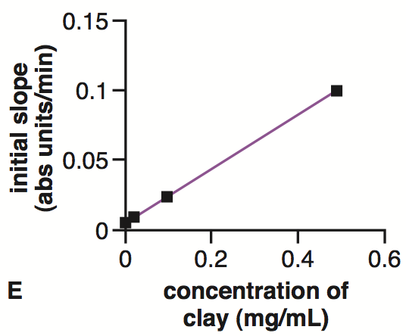
Fig. 4.11
Clay Concentration Effects
C, D, E. modified from Hanczyc et al., 2003.
Copyright © 2015 by AM Campbell, LJ Heyer, CJ Paradise. All rights reserved.
Notes:
Figure 4.11 Fatty acid structures and vesicle formation rates. A, Myristoleate chemical structure. B, Fatty acid monolayer forming a micelle and a bilayer forming a membrane vesicle. C, Effects of different solid surfaces for vesicle formation. D, Effects of different concentrations of clay on vesicle formation. E, Initial rates of vesicle formation based on clay concentrations.
Talking point: Rate of vesicle formation is directly proportional to the concentration of clay.

Slide 20
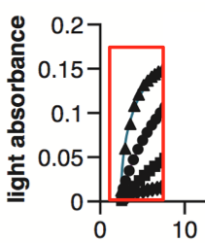
Fig. 4.11
Clay Concentration Effects
0.5
vesicle formation
is proportional to
clay concentration
0.1
0.02
C, D, E. modified from Hanczyc et al., 2003.
Copyright © 2015 by AM Campbell, LJ Heyer, CJ Paradise. All rights reserved.
Notes:
Figure 4.11 Fatty acid structures and vesicle formation rates. A, Myristoleate chemical structure. B, Fatty acid monolayer forming a micelle and a bilayer forming a membrane vesicle. C, Effects of different solid surfaces for vesicle formation. D, Effects of different concentrations of clay on vesicle formation. E, Initial rates of vesicle formation based on clay concentrations.
Talking point: Showing how previous graph is related to the current figure.

Slide 21
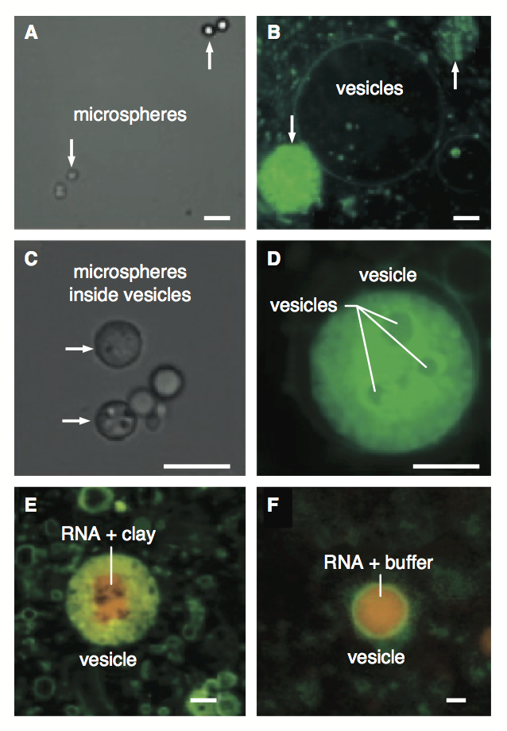
Fig. 4.12
Microspheres Inside Vesicles
beads visualized
lipids visualized
A – D: modified from Hanczyc et al., 2003; E, F: modified from Hanczyc, et al., 2003
Copyright © 2015 by AM Campbell, LJ Heyer, CJ Paradise. All rights reserved.
Notes:
Figure 4.12 Microscopy of spontaneous vesicles with cargo. Green-stained fatty acids were mixed with negatively charged ceramic microspheres. White light in panels (A) and (C) to emphasize the microspheres. Green fluorescence in panels (B) and (D) to highlight the vesicles. Red-stained RNA attached to clay (E) or in solution (F) trapped inside vesicles. Scale bars are 5 µm in A-D and 1 µm in E and F.
Talking point: Abiotic vesicle formation can trap small ceramic beads inside.

Slide 22
Fig. 4.12
Abiotic Vesicles Capture Cargo
beads inside
vesicles
vesicles inside
vesicles
A – D: modified from Hanczyc et al., 2003; E, F: modified from Hanczyc, et al., 2003
Copyright © 2015 by AM Campbell, LJ Heyer, CJ Paradise. All rights reserved.
Notes:
Figure 4.12 Microscopy of spontaneous vesicles with cargo. Green-stained fatty acids were mixed with negatively charged ceramic microspheres. White light in panels (A) and (C) to emphasize the microspheres. Green fluorescence in panels (B) and (D) to highlight the vesicles. Red-stained RNA attached to clay (E) or in solution (F) trapped inside vesicles. Scale bars are 5 µm in A-D and 1 µm in E and F.
Talking point: Abiotic vesicles can trap smaller vesicles inside.

Slide 23
Fig. 4.12
RNA Cargo in Vesicles
RNA inside vesicles
A – D: modified from Hanczyc et al., 2003; E, F: modified from Hanczyc, et al., 2003
Copyright © 2015 by AM Campbell, LJ Heyer, CJ Paradise. All rights reserved.
Notes:
Figure 4.12 Microscopy of spontaneous vesicles with cargo. Green-stained fatty acids were mixed with negatively charged ceramic microspheres. White light in panels (A) and (C) to emphasize the microspheres. Green fluorescence in panels (B) and (D) to highlight the vesicles. Red-stained RNA attached to clay (E) or in solution (F) trapped inside vesicles. Scale bars are 5 µm in A-D and 1 µm in E and F.
Talking point: RNA can be trapped inside abiotic vesicles. RNA could be in the form of a ribozyme that could polymerize RNA.

Slide 24
Fig. 4.12
RNA Cargo in Vesicles
What chemical property of RNA
could enhance its capacity to catalyze
the formation of lipid vesicles?
A – D: modified from Hanczyc et al., 2003; E, F: modified from Hanczyc, et al., 2003
Copyright © 2015 by AM Campbell, LJ Heyer, CJ Paradise. All rights reserved.
Notes:
Figure 4.12 Microscopy of spontaneous vesicles with cargo. Green-stained fatty acids were mixed with negatively charged ceramic microspheres. White light in panels (A) and (C) to emphasize the microspheres. Green fluorescence in panels (B) and (D) to highlight the vesicles. Red-stained RNA attached to clay (E) or in solution (F) trapped inside vesicles. Scale bars are 5 µm in A-D and 1 µm in E and F.
Talking point: RNA can be trapped inside abiotic vesicles. RNA could be in the form of a ribozyme that could polymerize RNA.

Slide 25
Fig. 4.12
RNA Cargo in Vesicles
What chemical property of RNA
could enhance its capacity to catalyze
the formation of lipid vesicles?
A – D: modified from Hanczyc et al., 2003; E, F: modified from Hanczyc, et al., 2003
Copyright © 2015 by AM Campbell, LJ Heyer, CJ Paradise. All rights reserved.
Notes:
Figure 4.12 Microscopy of spontaneous vesicles with cargo. Green-stained fatty acids were mixed with negatively charged ceramic microspheres. White light in panels (A) and (C) to emphasize the microspheres. Green fluorescence in panels (B) and (D) to highlight the vesicles. Red-stained RNA attached to clay (E) or in solution (F) trapped inside vesicles. Scale bars are 5 µm in A-D and 1 µm in E and F.
Talking point: RNA has a negative charge which catalyzes abiotic formation of vesicles.

Slide 26
Fig. 4.12
RNA Cargo in Vesicles
RNA can function as enzymes
inside lipid bilayer
A – D: modified from Hanczyc et al., 2003; E, F: modified from Hanczyc, et al., 2003
Copyright © 2015 by AM Campbell, LJ Heyer, CJ Paradise. All rights reserved.
Notes:
Figure 4.12 Microscopy of spontaneous vesicles with cargo. Green-stained fatty acids were mixed with negatively charged ceramic microspheres. White light in panels (A) and (C) to emphasize the microspheres. Green fluorescence in panels (B) and (D) to highlight the vesicles. Red-stained RNA attached to clay (E) or in solution (F) trapped inside vesicles. Scale bars are 5 µm in A-D and 1 µm in E and F.
Talking point: This experiment makes it seem plausible that abiotic vesicles could enclose self-replicating RNA genomes.

Slide 27
Fig. 4.12
Are Abiotic Vesicles Empty?
A – D: modified from Hanczyc et al., 2003; E, F: modified from Hanczyc, et al., 2003
Copyright © 2015 by AM Campbell, LJ Heyer, CJ Paradise. All rights reserved.
Notes:
Figure 4.12 Microscopy of spontaneous vesicles with cargo. Green-stained fatty acids were mixed with negatively charged ceramic microspheres. White light in panels (A) and (C) to emphasize the microspheres. Green fluorescence in panels (B) and (D) to highlight the vesicles. Red-stained RNA attached to clay (E) or in solution (F) trapped inside vesicles. Scale bars are 5 µm in A-D and 1 µm in E and F.

Slide 28
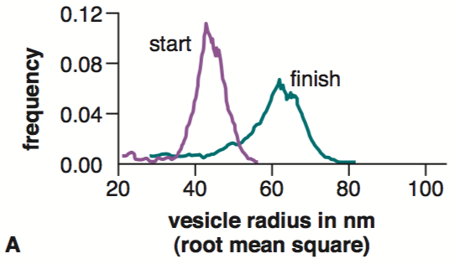
Fig. 4.13
Dynamic Vesicle Sizes
modified from From Hanczyc et al., 2003
Copyright © 2015 by AM Campbell, LJ Heyer, CJ Paradise. All rights reserved.
Notes:
Figure 4.13 Changes in vesicle sizes. A, Small starting vesicles grew larger after the addition of micelles. B, Vesicles grew over time when the experiment was sampled periodically. C, Mean diameter plus standard deviation of four measurements demonstrates reproducibility of vesicle growth.
Talking point: Small vesicles grow in size after being “fed” with lipid micelles.

Slide 29
Fig. 4.13
Dynamic Vesicle Sizes
avg. starting size
modified from From Hanczyc et al., 2003
Copyright © 2015 by AM Campbell, LJ Heyer, CJ Paradise. All rights reserved.
Notes:
Figure 4.13 Changes in vesicle sizes. A, Small starting vesicles grew larger after the addition of micelles. B, Vesicles grew over time when the experiment was sampled periodically. C, Mean diameter plus standard deviation of four measurements demonstrates reproducibility of vesicle growth.
Talking Point: Starting radius before “feeding”.

Slide 30
Fig. 4.13
Dynamic Vesicle Sizes
add micelles to vesicles
modified from From Hanczyc et al., 2003
Copyright © 2015 by AM Campbell, LJ Heyer, CJ Paradise. All rights reserved.
Notes:
Figure 4.13 Changes in vesicle sizes. A, Small starting vesicles grew larger after the addition of micelles. B, Vesicles grew over time when the experiment was sampled periodically. C, Mean diameter plus standard deviation of four measurements demonstrates reproducibility of vesicle growth.
Talking Point: Feed vesicles more lipid in non-vesicle format.

Slide 31
Fig. 4.13
Dynamic Vesicle Sizes
vesicles get bigger
modified from From Hanczyc et al., 2003
Copyright © 2015 by AM Campbell, LJ Heyer, CJ Paradise. All rights reserved.
Notes:
Figure 4.13 Changes in vesicle sizes. A, Small starting vesicles grew larger after the addition of micelles. B, Vesicles grew over time when the experiment was sampled periodically. C, Mean diameter plus standard deviation of four measurements demonstrates reproducibility of vesicle growth.
Talking Point: Vesicles grow in diameter, surface area and volume when fed.

Slide 32
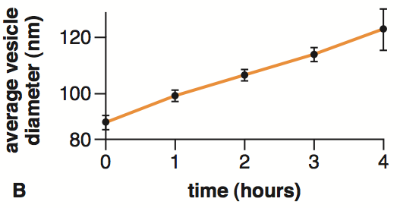
Fig. 4.13
Dynamic Vesicle Sizes
vesicles get bigger
the longer they “feed”
modified from From Hanczyc et al., 2003
Copyright © 2015 by AM Campbell, LJ Heyer, CJ Paradise. All rights reserved.
Notes:
Figure 4.13 Changes in vesicle sizes. A, Small starting vesicles grew larger after the addition of micelles. B, Vesicles grew over time when the experiment was sampled periodically. C, Mean diameter plus standard deviation of four measurements demonstrates reproducibility of vesicle growth.
Talking point: Short term experiments accelerate natural condition. In nature, the time line could be much longer than people are willing to wait for experimental results.

Slide 33
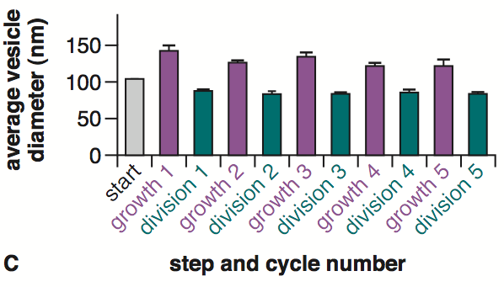
Fig. 4.13
Dynamic Vesicle Sizes
modified from From Hanczyc et al., 2003
Copyright © 2015 by AM Campbell, LJ Heyer, CJ Paradise. All rights reserved.
Notes:
Figure 4.13 Changes in vesicle sizes. A, Small starting vesicles grew larger after the addition of micelles. B, Vesicles grew over time when the experiment was sampled periodically. C, Mean diameter plus standard deviation of four measurements demonstrates reproducibility of vesicle growth.
Talking point: Final results from repeated trials of abiotic vesicle growth in size and number.

Slide 34
Fig. 4.13
Dynamic Vesicle Sizes
starting size of abiotic vesicles
modified from From Hanczyc et al., 2003
Copyright © 2015 by AM Campbell, LJ Heyer, CJ Paradise. All rights reserved.
Notes:
Figure 4.13 Changes in vesicle sizes. A, Small starting vesicles grew larger after the addition of micelles. B, Vesicles grew over time when the experiment was sampled periodically. C, Mean diameter plus standard deviation of four measurements demonstrates reproducibility of vesicle growth.
Talking point: Original diameter of vesicles before “feeding” them more lipids.

Slide 35
Fig. 4.13
Dynamic Vesicle Sizes
vesicles grow when “fed” micelles
modified from From Hanczyc et al., 2003
Copyright © 2015 by AM Campbell, LJ Heyer, CJ Paradise. All rights reserved.
Notes:
Figure 4.13 Changes in vesicle sizes. A, Small starting vesicles grew larger after the addition of micelles. B, Vesicles grew over time when the experiment was sampled periodically. C, Mean diameter plus standard deviation of four measurements demonstrates reproducibility of vesicle growth.
Talking point: Size of vesicles after “feeding”. The abiotic vesicles grew from ~100 nm diameter to ~150 nm diameter.

Slide 36
Fig. 4.13
Dynamic Vesicle Sizes
vesicles divide when
forced through filter
modified from From Hanczyc et al., 2003
Copyright © 2015 by AM Campbell, LJ Heyer, CJ Paradise. All rights reserved.
Notes:
Figure 4.13 Changes in vesicle sizes. A, Small starting vesicles grew larger after the addition of micelles. B, Vesicles grew over time when the experiment was sampled periodically. C, Mean diameter plus standard deviation of four measurements demonstrates reproducibility of vesicle growth.
Talking point: Size of vesicles after “feeding”. The abiotic vesicles grew from ~100 nm diameter to ~150 nm diameter.

Slide 37
Fig. 4.13
Dynamic Vesicle Sizes
growth and division
repeated
modified from From Hanczyc et al., 2003
Copyright © 2015 by AM Campbell, LJ Heyer, CJ Paradise. All rights reserved.
Notes:
Figure 4.13 Changes in vesicle sizes. A, Small starting vesicles grew larger after the addition of micelles. B, Vesicles grew over time when the experiment was sampled periodically. C, Mean diameter plus standard deviation of four measurements demonstrates reproducibility of vesicle growth.
Talking point: Vesicles lost about 50% in diameter or radius. This loss is linear.

Slide 38
Fig. 4.13
Dynamic Vesicle Sizes
five cycles of abiotic growth and division
modified from From Hanczyc et al., 2003
Copyright © 2015 by AM Campbell, LJ Heyer, CJ Paradise. All rights reserved.
Notes:
Figure 4.13 Changes in vesicle sizes. A, Small starting vesicles grew larger after the addition of micelles. B, Vesicles grew over time when the experiment was sampled periodically. C, Mean diameter plus standard deviation of four measurements demonstrates reproducibility of vesicle growth.
Talking point: Abiotic growth and reproduction was repeated 4 additional times to demonstrate the observations were not due to simply good luck.

Slide 39
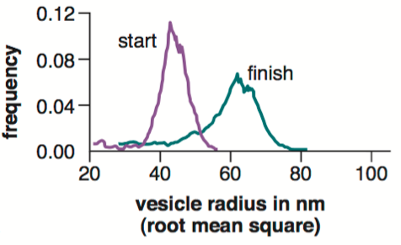
IQ #13
Dynamic Vesicle Sizes
modified from From Hanczyc et al., 2003
Copyright © 2015 by AM Campbell, LJ Heyer, CJ Paradise. All rights reserved.
Notes:
IQ #13 As a vesicle grows in size, its volume and surface area change at different rates. Calculate the volumes and surface areas for the two major size classes of vesicles in Figure 4.13A. Use the highest point in the two graphs to estimate the radii for the two populations of vesicles. The formula for the surface area of a sphere is 4π r², and the formula for the volume of a sphere is 4/3 π r³. Calculate the percent change in vesicle radius, surface area and volume. You should complete this table:
Talking point: The mathematics of vesicle growth leads to an interesting discovery.

Slide 40
IQ #13
Width Increases
45
62
38%
modified from From Hanczyc et al., 2003
Copyright © 2015 by AM Campbell, LJ Heyer, CJ Paradise. All rights reserved.
Notes:
IQ #13 As a vesicle grows in size, its volume and surface area change at different rates. Calculate the volumes and surface areas for the two major size classes of vesicles in Figure 4.13A. Use the highest point in the two graphs to estimate the radii for the two populations of vesicles. The formula for the surface area of a sphere is 4π r², and the formula for the volume of a sphere is 4/3 π r³. Calculate the percent change in vesicle radius, surface area and volume. You should complete this table:
Talking point: Estimated radius of vesicles before and after “consuming” lipids. Could do the same for data in Figure 4.13.

Slide 41
IQ #13
Surface Area Doubles
45
25,400
62
48,300
+38%
+90%
modified from From Hanczyc et al., 2003
Copyright © 2015 by AM Campbell, LJ Heyer, CJ Paradise. All rights reserved.
Notes:
IQ #13 As a vesicle grows in size, its volume and surface area change at different rates. Calculate the volumes and surface areas for the two major size classes of vesicles in Figure 4.13A. Use the highest point in the two graphs to estimate the radii for the two populations of vesicles. The formula for the surface area of a sphere is 4π r², and the formula for the volume of a sphere is 4/3 π r³. Calculate the percent change in vesicle radius, surface area and volume. You should complete this table:
Talking point: Calculated surface areas of vesicles before and after “consuming” lipids. Could do the same for data in Figure 4.13. Surface area grows with the square of the radius.

Slide 42
IQ #13
Volume More Than Doubles
45
25,400
381,500
62
48,300
997,800
+38%
+90%
+262%
modified from From Hanczyc et al., 2003
Copyright © 2015 by AM Campbell, LJ Heyer, CJ Paradise. All rights reserved.
Notes:
IQ #13 As a vesicle grows in size, its volume and surface area change at different rates. Calculate the volumes and surface areas for the two major size classes of vesicles in Figure 4.13A. Use the highest point in the two graphs to estimate the radii for the two populations of vesicles. The formula for the surface area of a sphere is 4π r², and the formula for the volume of a sphere is 4/3 π r³. Calculate the percent change in vesicle radius, surface area and volume. You should complete this table:
Talking point: Calculated volume of vesicles before and after “consuming” lipids. Could do the same for data in Figure 4.13. Volume grows with the cubed root of the radius.

