Slide 1
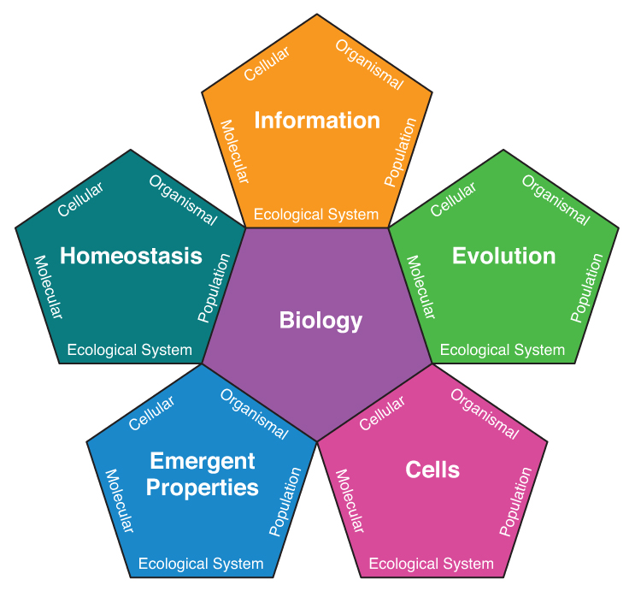
Integrating Concepts in Biology
PowerPoint Slides for Chapter 4:
Evolution and Origin of Cells
4.1 What is evolution?
by A. Malcolm Campbell, Laurie J. Heyer, & Christopher Paradise
Copyright © 2015 by AM Campbell, LJ Heyer, CJ Paradise. All rights reserved.

Slide 2
Biology Learning Objectives
Define evolution and distinguish the four mechanisms of evolution.
Illustrate how natural selection works by giving a real example.
ELSI Learning Objectives
Distinguish religion and science as two different ways of understanding the world.
Evaluate the difference between belief and acceptance of evolution.
Define the scientific term theory.
Copyright © 2015 by AM Campbell, LJ Heyer, CJ Paradise. All rights reserved.

Slide 3
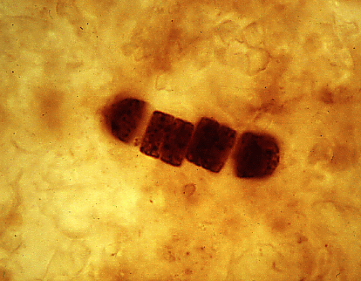
Opening Figure
Fossil Evidence of Early Life
William Schopf, UCLA
Notes:
Opening Figure: One billion year old microbe fossil.
Talking point: Detail of microbe fossil dated by the age of the surrounding rock.

Slide 4
Change in allele frequency in a population over time.
Define Evolution

Slide 5
Change in allele frequency in a population over time.
Define Theory
An understanding that has been validated so often it is accepted as true beyond doubt

Slide 6
Themes of Evolution
The origin of living systems occurred by natural processes, and life continues to evolve within a changing environment.
Organisms can be linked by lines of descent from common ancestry.
Natural selection is a mechanism of evolution that accounts for adaptation.
Human activity can alter the course of evolution.

Slide 7
Properties of Life
life replicates itself
life undergoes changes
life requires energy
life occupies three-dimensional space big enough to contain cargo

Slide 8
Fig. 4.1
Natural Selection Example
Five tenants of natural selection:
Copyright © 2015 by AM Campbell, LJ Heyer, CJ Paradise. All rights reserved.
Notes:
Figure 4.1 Example of natural selection. A, Overproduction of a variety of acorns leads to competition for the limited resource of light. B, Faster germinating acorns grow first and shade out their competition. C, Those with the selective advantage survive, reproduce, and propagate the trait of fast germination in the next generation.
Talking point: This panel shows two tenants of natural selection. You can have the students name them.

Slide 9
Fig. 4.1
Natural Selection Example
Five tenants of natural selection: 1) overproduction = limited resources
2) variation in the population
Copyright © 2015 by AM Campbell, LJ Heyer, CJ Paradise. All rights reserved.
Notes:
Figure 4.1 Example of natural selection. A, Overproduction of a variety of acorns leads to competition for the limited resource of light. B, Faster germinating acorns grow first and shade out their competition. C, Those with the selective advantage survive, reproduce, and propagate the trait of fast germination in the next generation.
Talking point: Overproduction means more progeny than the environment can support. Variation in the population (represented by different shapes of acorns).

Slide 10
Fig. 4.1
Natural Selection Example
Five tenants of natural selection: 1) overproduction = limited resources
2) variation in the population
3) competition for resources
Copyright © 2015 by AM Campbell, LJ Heyer, CJ Paradise. All rights reserved.
Notes:
Figure 4.1 Example of natural selection. A, Overproduction of a variety of acorns leads to competition for the limited resource of light. B, Faster germinating acorns grow first and shade out their competition. C, Those with the selective advantage survive, reproduce, and propagate the trait of fast germination in the next generation.
Talking point: Competition for limited resource of light.

Slide 11
Fig. 4.1
Natural Selection Example
Five tenants of natural selection: 1) overproduction = limited resources
2) variation in the population
3) competition for resources
4) adaptive advantage for some.
5) reproduction for those who survive.
Copyright © 2015 by AM Campbell, LJ Heyer, CJ Paradise. All rights reserved.
Notes:
Figure 4.1 Example of natural selection. A, Overproduction of a variety of acorns leads to competition for the limited resource of light. B, Faster germinating acorns grow first and shade out their competition. C, Those with the selective advantage survive, reproduce, and propagate the trait of fast germination in the next generation.
Talking point: Adaptive advantage of fast germination and growth (physiological variation) leads to reproduction of too many acorns and the cycle repeats.

Slide 12
Working in your group, apply natural selection to cancer. Make sure to keep in mind the true definition of evolution.

Slide 13
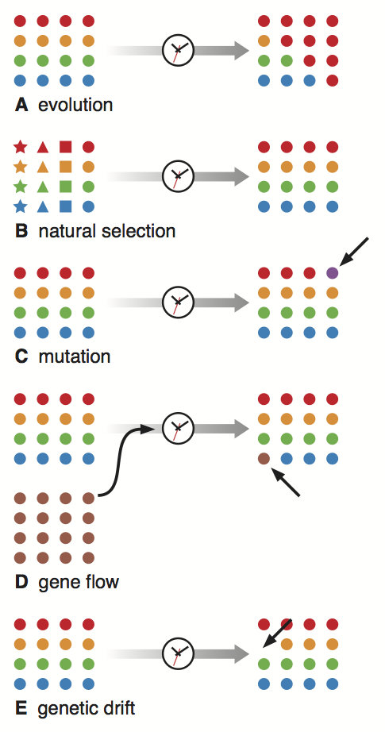
Fig. 4.2
Definition of Evolution
Copyright © 2015 by AM Campbell, LJ Heyer, CJ Paradise. All rights reserved.
Notes:
Figure 4.2 Evolution and the four mechanisms of evolution. A, Depiction of evolution where circles represent individuals in a population with different alleles (colors). The frequency of alleles changes over time. B, Natural selection favors circles that are allowed to reproduce. C, Mutation is the appearance of a new allele through DNA change. D, Gene flow is the arrival of a new allele from a different population. E, Genetic drift is the arbitrary loss of an allele through a process not related to natural selection.
Talking point: This panel illustrates the definition of evolution. Students can be asked to define evolution.

Slide 14
Fig. 4.2
Definition of Evolution
change in allele frequency in a population over time
Copyright © 2015 by AM Campbell, LJ Heyer, CJ Paradise. All rights reserved.
Notes:
Figure 4.2 Evolution and the four mechanisms of evolution. A, Depiction of evolution where circles represent individuals in a population with different alleles (colors). The frequency of alleles changes over time. B, Natural selection favors circles that are allowed to reproduce. C, Mutation is the appearance of a new allele through DNA change. D, Gene flow is the arrival of a new allele from a different population. E, Genetic drift is the arbitrary loss of an allele through a process not related to natural selection.
Talking point: This is the definition of evolution. On the left, there are 4 circles of each color representing equal abundance of each allele/phenotype. Over time, the frequency of alleles in the population changes so that 10 out of 16 are the red allele/phenotype.

Slide 15
Fig. 4.2
Four Mechanisms of Evolution
Copyright © 2015 by AM Campbell, LJ Heyer, CJ Paradise. All rights reserved.
Notes:
Figure 4.2 Evolution and the four mechanisms of evolution. A, Depiction of evolution where circles represent individuals in a population with different alleles (colors). The frequency of alleles changes over time. B, Natural selection favors circles that are allowed to reproduce. C, Mutation is the appearance of a new allele through DNA change. D, Gene flow is the arrival of a new allele from a different population. E, Genetic drift is the arbitrary loss of an allele through a process not related to natural selection.
Talking point: Natural selection is one of four mechanisms of evolution. The different shapes (alleles) are selected against through natural selection so that only round alleles survive and reproduce.

Slide 16
Fig. 4.2
Four Mechanisms of Evolution
Copyright © 2015 by AM Campbell, LJ Heyer, CJ Paradise. All rights reserved.
Notes:
Figure 4.2 Evolution and the four mechanisms of evolution. A, Depiction of evolution where circles represent individuals in a population with different alleles (colors). The frequency of alleles changes over time. B, Natural selection favors circles that are allowed to reproduce. C, Mutation is the appearance of a new allele through DNA change. D, Gene flow is the arrival of a new allele from a different population. E, Genetic drift is the arbitrary loss of an allele through a process not related to natural selection.
Talking point: Another mechanism of evolution is mutation which creates a new allele (purple circle) that did not exist previously in the population. Chapter 5 looks at mutations and the evolution of new species.

Slide 17
Fig. 4.2
Four Mechanisms of Evolution
Copyright © 2015 by AM Campbell, LJ Heyer, CJ Paradise. All rights reserved.
Notes:
Figure 4.2 Evolution and the four mechanisms of evolution. A, Depiction of evolution where circles represent individuals in a population with different alleles (colors). The frequency of alleles changes over time. B, Natural selection favors circles that are allowed to reproduce. C, Mutation is the appearance of a new allele through DNA change. D, Gene flow is the arrival of a new allele from a different population. E, Genetic drift is the arbitrary loss of an allele through a process not related to natural selection.
Talking point: A third mechanism of evolution is gene flow where a new allele (brown circle) is brought into a population through mating with an individual from a different population.

Slide 18
Fig. 4.2
Four Mechanisms of Evolution
Copyright © 2015 by AM Campbell, LJ Heyer, CJ Paradise. All rights reserved.
Notes:
Figure 4.2 Evolution and the four mechanisms of evolution. A, Depiction of evolution where circles represent individuals in a population with different alleles (colors). The frequency of alleles changes over time. B, Natural selection favors circles that are allowed to reproduce. C, Mutation is the appearance of a new allele through DNA change. D, Gene flow is the arrival of a new allele from a different population. E, Genetic drift is the arbitrary loss of an allele through a process not related to natural selection.
Talking point: The final mechanism is genetic drift which happens by chance, not selection of fitness, and is the loss of an allele (blank spot marked by arrow) from a population. Drift typically happens in small and/or isolated populations.

Slide 19
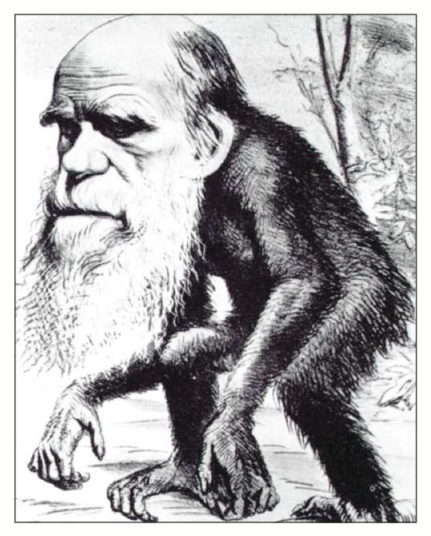
ELSI Fig. 4.1
Political Satire of Darwin
public domain
Notes:
ELSI Figure 4.1 Nineteenth century political cartoon of Charles Darwin. The concept of descent from a common ancestor was not fully understood by Victorian England, so Darwin was ridiculed as being a buffoon.
Talking point: Since Darwin’s publication, supporting the scientific understanding of evolution has generated ridicule and condemnation. The criticism comes from sources of faith and not science even though the two areas do not address the same aspects of life. Evolution is based on data, not faith.

Slide 20
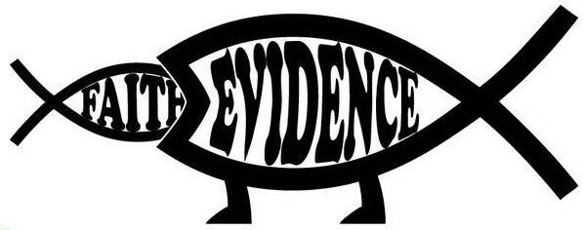
Why are religion and evolution often pitted against each other?

