Slide 1
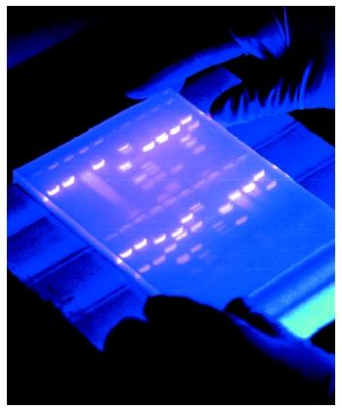
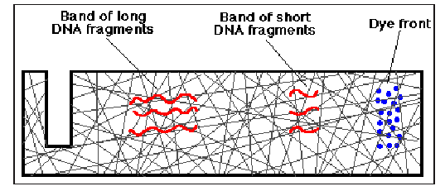
Troubleshooting 1.0: Analyzing results in a gel
+

Slide 2
What is going on here?
0
1
2
3
4
5
2000 ->
1000 ->

Slide 3
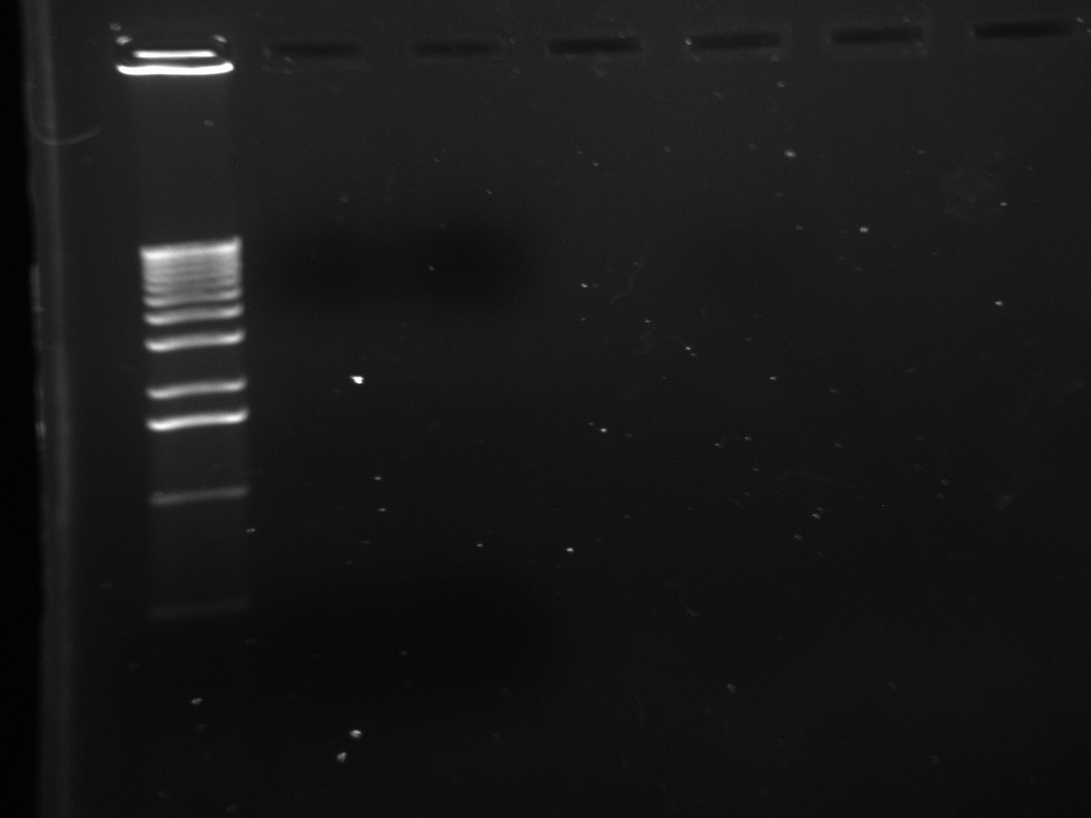
What’s in this gel?
Notes:
Only Ladder

Slide 4
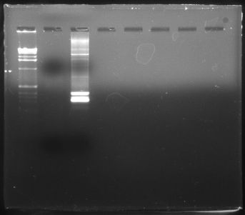
What’s in this gel?

Slide 5
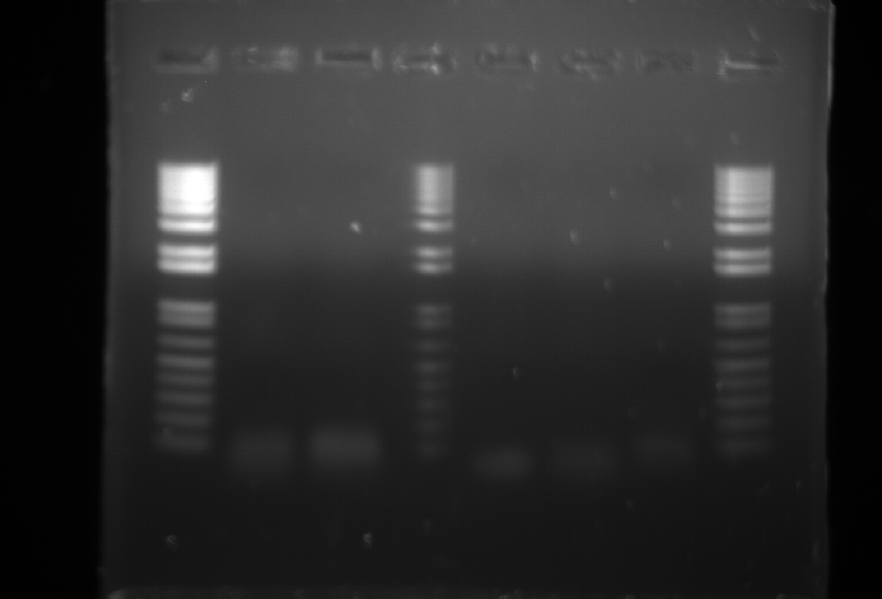
What’s in this gel?
Notes:
Only Ladder

Slide 6
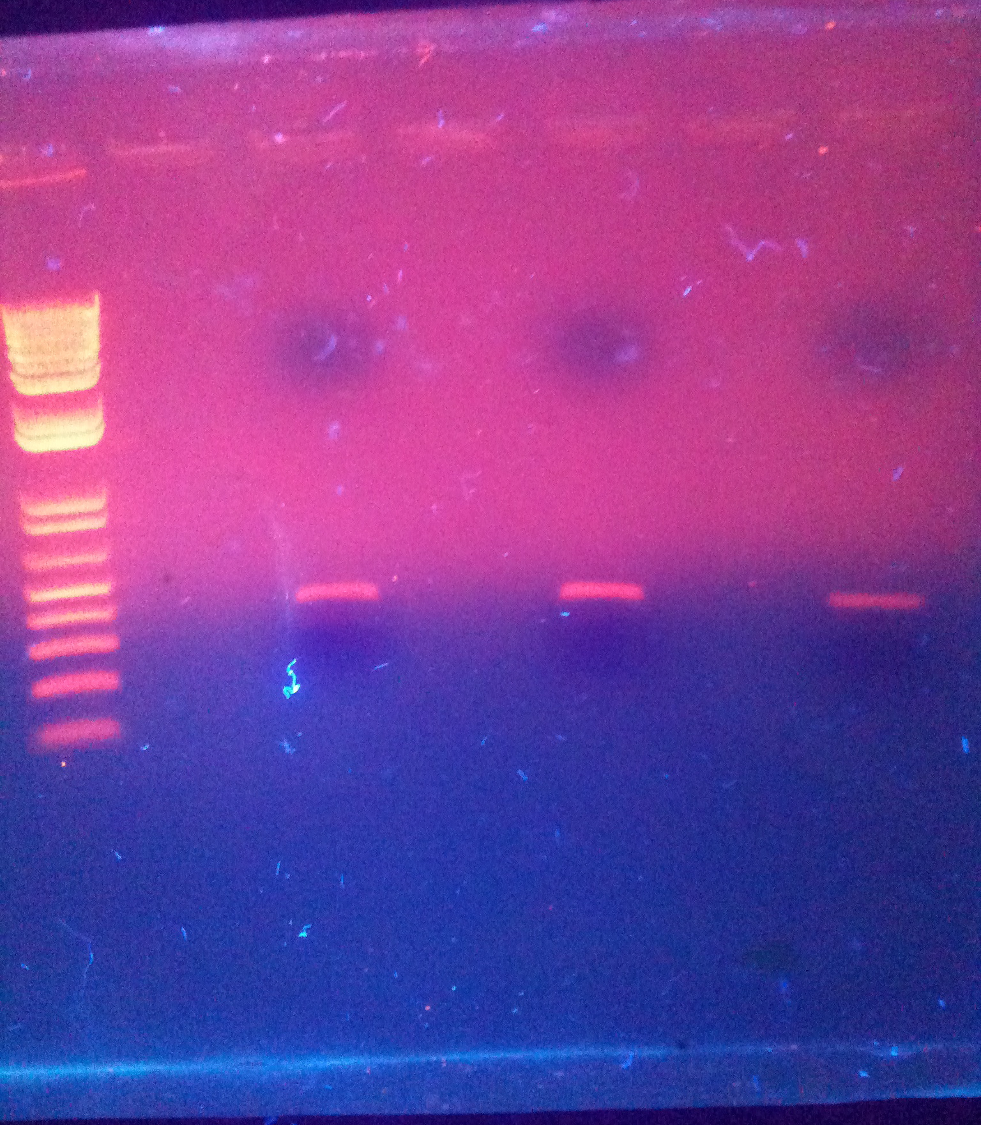
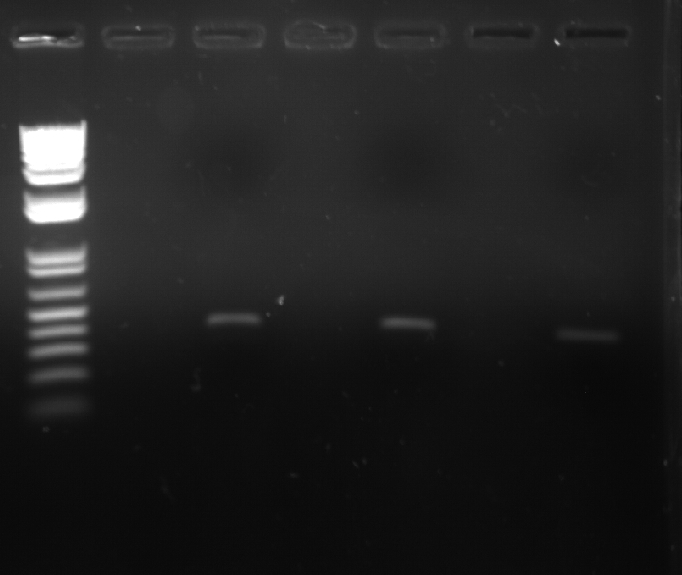
What’s in this gel?
Notes:
Only Ladder

Slide 7
Basic Gel Components

Slide 8
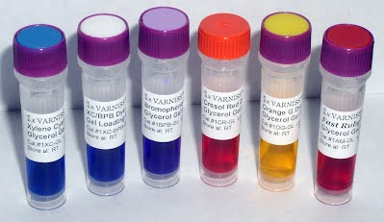
Gel Loading Buffer
What are the benefits of using gel loading buffer?

Slide 9
Key Characteristics
High density solutions; typically with glycerol or sucrose
Contain one or more tracking dyes
  Bromophenol blue, xylene cyanol, etc.
Note: We use the Type III loading buffer described in Maniatis which is a 6X buffer of 0.25% bromophenol blue, 0.25% xylene cyanol, and 30% glycerol

Slide 10
Gel Polymerization Buffer
What are the purpose of the agarose gel buffer (TBE)?

Slide 11
Basics
Several types of buffers all using EDTA (pH 8.0): TAE, TBE, LB (pH 7.5-7.8)
The composition and ionic strength of the buffer determines DNA mobility through the gel
  No buffer = little to no movement
  Too much or too strong buffer = lots of heat/melting

Slide 12
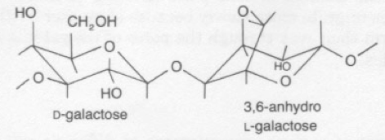
Agarose
Linear polymer derived from seaweed
Contaminated with other polysaccharides, proteins, and salts

Slide 13
Intercalating Dyes
Fluorescent dye used to detect DNA in gels
  Examples: EtBr, Syber-Safe, Glo-Green
Reduces electrophoretic mobility of linear DNA by intercalating between stacked pairs causing increased rigidity
Carcinogenic and should be handled carefully

Slide 14
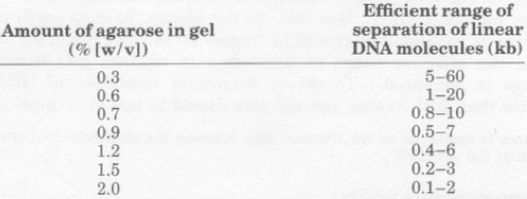
Factor that affects DNA migration
Agarose Concentration
  Different concentrations of agarose result in different migration rates

Slide 15
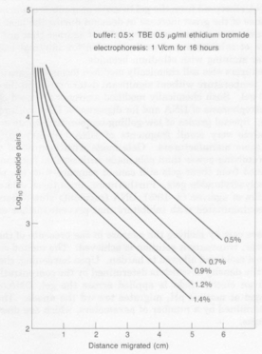
There is a linear relationship between the logarithm of electrophoretic mobility and gel concentration
By altering the gel concentration, the size range effectively separated by a gel can be changed.

