Slide 1

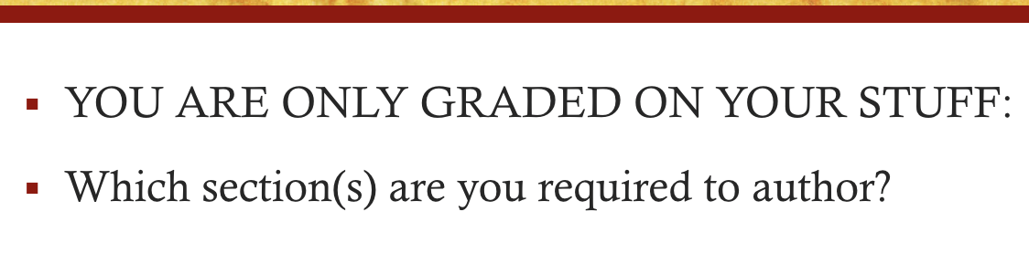
writingDraft 1

Slide 2
Title
INCLUDE:
Something about methods
Something about your specimen
What you predict you should find
There should be <100 characters (not including spaces)

Slide 3
Abstract
Do you have a purpose?
What are some of your methods? (hint: PCR)
What are some Predicted Results (provide information such as):
band size
primer temperature

Slide 4
Abstract
Do you have a purpose?
What are some of your methods? (hint: PCR)
What are some Predicted Results (provide information such as):
band size
primer temperature

Slide 5
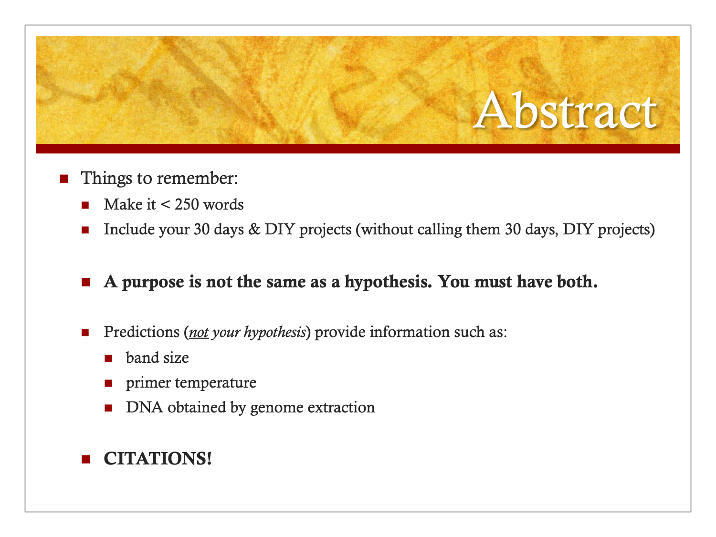

Slide 6
Introduction
Please keep it 3-4 paragraphs long
Give background information
Provide a hint of expected findings
CITATIONS.

Slide 7
Methods
LOTS of detail: could someone else do this all again with only your methods section?
…in paragraph format.
Include PCR methods, Genome Prep, and 30 Days methods/plan if seek extra credit.
Make sure it is all in past tense

Slide 8
Predicted Results
“We predict…[what]…because…[why]…(citation).”
(Otherwise cannot earn any points ☹)
They are not fake data.
Include:
Band length
Temperatures
DNA concentration
Any other numbers?
Genome Prep (30 days if want to propose it for ec)

Slide 9
Discussion
Why did you predict the results you did?
Do you have a thesis/point?
Did you back it up with citations?

Slide 10
Predicted Figures
Does it address the research question(s)?
Does it look like a scientist made it?
Could you just read the legend and know what the paper is about?
No fake data.
You can predict what a gel will look like—so we should see a drawing of a gel prototype.

