Slide 1
Polymerase Chain Reaction

Slide 2
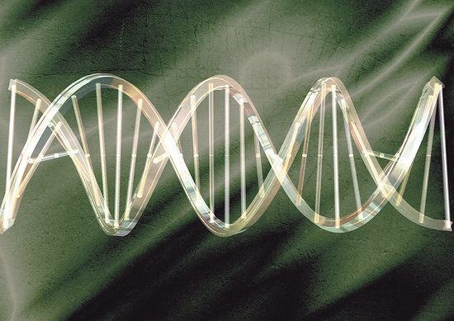
DNA Structure:
Two strands in helix
Adenine ( A ) binds to Thymine ( T ), with two hydrogen bonds.
Guanine ( G ) binds to Cytosine ( C ), with three hydrogen bonds.
Notes:
A purine always links with a pyrimidine base to maintain the structure of DNA.

Slide 3
DNA
Helix is double-stranded & “antiparallel”-Primary strand (sense)
5’- CCGAATGGGATGCTGGGATGC -3’
3’- GGCTTACCCTACGACCCTACG -5’ Complementary strand (antisense)
PCR Primer is a (short single strand): 5’- CCGAAGGATGC -3’

Slide 4
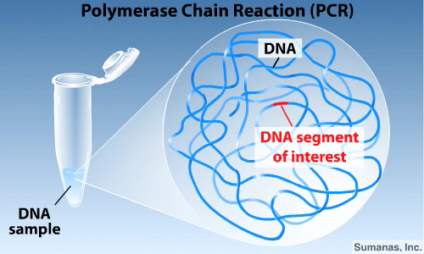
Show movie, repeat it and have students attempt to serve as narrator

Slide 5
Show movie, https://youtu.be/JmveVAYKylk, and have students attempt to serve as narrator
https://youtu.be/JmveVAYKylk

Slide 6
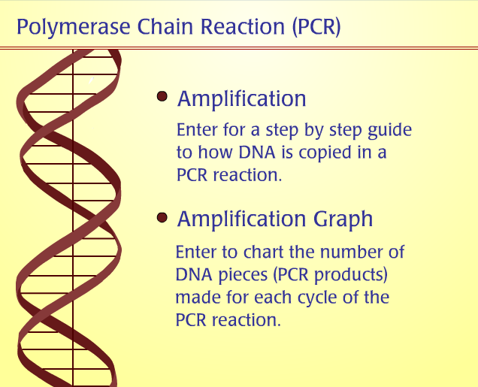

Slide 7
PCR- Recap
By using primers & varying temperatures…
  TARGET & AMPLIFY desired DNA segment

Slide 8
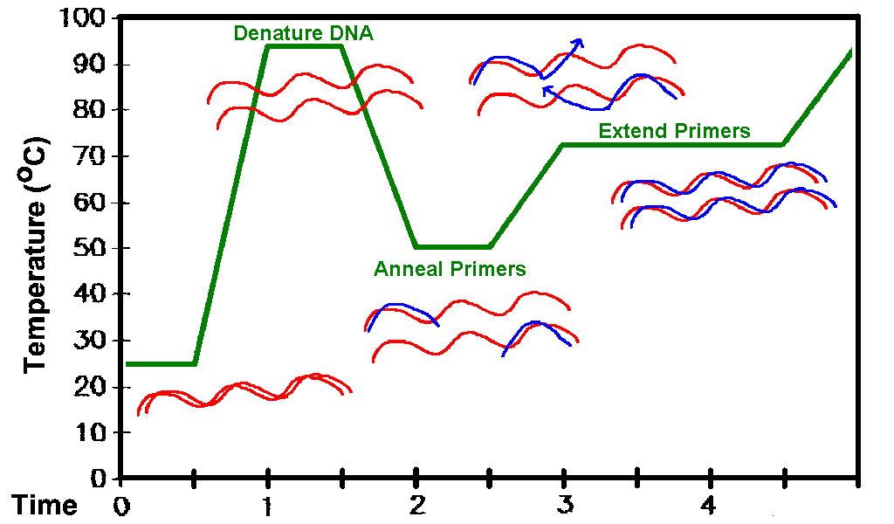
The temp cycle of PCR

Slide 9
PCR Quiz
What are the 3 stages called?
What temperatures used?
What’s happening at each temperature?
In the end: How do you know if it worked?

Slide 10
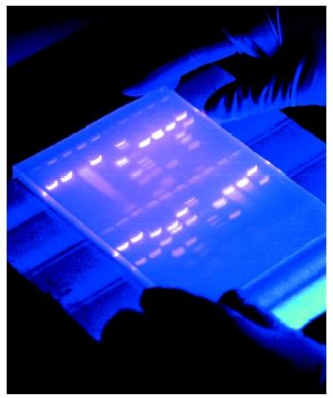
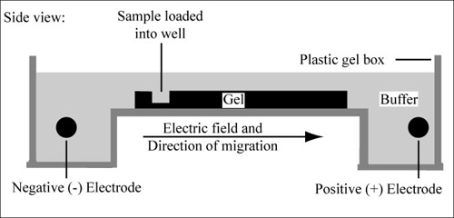
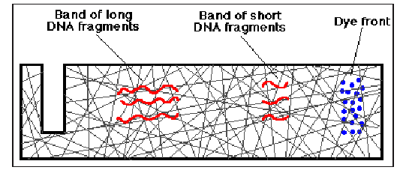
How Does a Gel Work?
Check a PCR sample by gel electrophoresis.
+

Slide 11

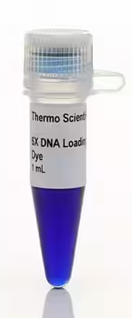
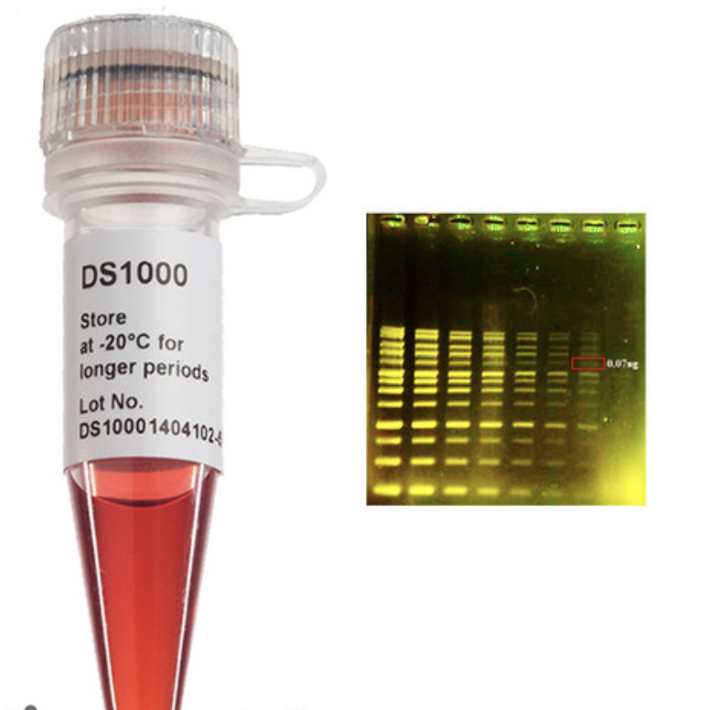
differing Dyes
(there are a number of different dyes used in gel electrophoresis)
-Loading buffer –often contains glycerol and two different dyes (e.g. bromophenol blue and xylene cyanol FF) which you can watch move as the gel is running.
-Visualizing stain –several different dyes can be used for visualizing DNA in agarose (ethidium bromide, SYBR-Safe, GreenGlo) when placed over UV light.

Slide 12
Chalk Session
5’-GGAATTGACTATCCTCTACTATTTCCTG-3’
1. Predict & Write Complementary Sequence
2. Design two 4-bp long primers
3. Predict length the final amplify product will be?
Notes:
12 deg C
8 deg C
24 bp long

Slide 13
Calculate Annealing Temp
“Rule of Thumb”:
Tm= 4(#G’s + C’s in primer) + 2(#A’s + T’s in primer)
“Lab Info” section of LB145 course website has additional info http://ctools.msu.edu/145

