Slide 1
Linking Art and Science
The detection of Anthocyanidin synthase in Rosa hybrida cultivar and Paris Art using PCR
By: Allison Ajluni, Cassandra Martin, and Ayesha Yalamarthy

Slide 2
Overview
Objective: Diagnose art using science
The presence of anthocyanidin synthase.
Anthocyanidin Synthase (ANS):
Ubiquitous gene coding for protein which produces red pigment.
Specimens:
Rosa hybrida cultivar aka ‘Charleston’ Roses
Rose Syrup
Paint Samples from Parisian street artists.
Testing: PCR detection of gene ANS.

Slide 3
Introduction
As indicated by Mikanagi et al., there exists 150+ species of roses worldwide
According to Pascual-Teresa et al., anthocyanin is a pigment that account for pinks and reds
Streisfeld et al., states that the gene for ANS is known as Anthocyanidin synthase
Hypothesis: ‘Charleston’ rose will contain gene. Rose syrup will not contain gene. Pink and red paint samples from France will contain gene.
Tests ~ PCR, Restriction Enzyme Digest

Slide 4
PARIS, France, and PCR
Paintings: Street Vendors in Paris, France
Same primers for paintings, roses and extract
PCR: establish presence of gene in art
Prior research by Wehling et al., indicated that flower pigments were traditionally used as dyes for paints.
Plausible: natural elements used in modern paints
If ANS present, band forming at 696bp

Slide 5
Methods
Plant Dehydration
Dilution series done to dilute rose syrup.
Charleston roses preserved using liquid nitrogen.
DNA Extraction and Purification
Using DNA extraction kits from Qiagen
Cocktail: Lab Manual pg 249
10 μL~ 10X PCR buffer
2 μL ~ 10mM dNTP
3 μL ~ 50mM MgCl2
5 μL ~ Primer mix (10 μL each)
1-20 μL ~ Template DNA
0.2-0.5 μL ~ Taq Polymerase
Up to 100 μL ~ Autoclaved Water
** Hypothetical, cocktail will be adjusted as necessary.

Slide 6
Methods Continued
Spectrophotometry
DNA absorbs UV light at 260nm.
Proteins absorb UV light at 280nm.
Concentration_{DNA}=[Absorbence_{(260nm)}xDilution(1/20)x50μL]
Purity_{DNA}=[Absorbence_{(260nm)}/Absorbence_{(280nm)}] .
PCR
4 samples and negative control. 3 trials
Tm­=64.9°C + 41°C*[(C’s+G’s)-16.4°C]/20 (Haenisch et al., 2009).
Forward primer = 58°C.
Reverse primer = 60°C.
Gel Electrophoresis
Well 1: 1 Kb DNA Ladder
Wells 2-5: PCR product and loading dye.
Well 6: negative control.
The voltage set at 290 volts.
The band length should be 696 bp (Mizutani, 2009).

Slide 7
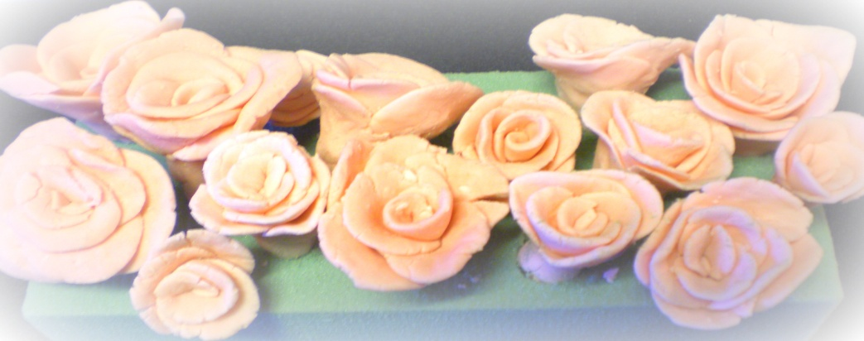
Methods Continued
Fondant
Melted gelatin, cold water, melted marshmallow fluff, shortening, and confectioners’ sugar.
Coloring Fondant
Rose syrup kneaded into fondant.
Fondant Roses
Fondant rolled into ball, flattened until thin. Rolled into scroll shape.
Placement of fondant petals: 3 pieces around center scroll. 5 pieces around petals.

Slide 8
The ANS Gene of the Charleston Rose, Rosa Hybrida Cultivar
5’-GAGTGGGGGG TGATGCACCT TGTCAACCAT GGCATCTCCG ACGAGCTCAT GGAACGGGTG AAGAAGGCCG GACAAGCCTT CTTTGATCTT CCCATTGAGC AGAAGGAGAA GTATGCCAAT GACCAGGCCT CGGGCAAAAT TCAAGGCTAC GGAAGCAAGC CTGAGGACAA GCGCGACTTG CAACTTGAGT GGGAGGACTA TTTTTCCAC ATTGTGGCAA CAAGCGAGTA CGCCAAGGAA TCCATTTGGC CTCAAACACC TTCCGATTAT ATTGTGGCAA CAAGCGAGTA CGCCAAGGAA CTGAGGGGGC TAGCAACCAA GATACTGACC GTACTCTCAC TTGGCTTGGG ATTAGAAGAA GGGAGGCTGG AGAAGGAGGT CGGTGGACTC GAAGAACTCG TCCTGCAAAT GAAAATCAAC TACTACCCAA AATGCCCTCA GCCGGAACTT GCCCTCGGCG TGGAAGCCCA CACCGACATA AGTGCACTCA CCTTCATCCT CCACAACATG GTTCCCGGCC TGCAGCTCTT CTACGGCGGC AAATGGGTGA CAGCGAAATG CGTGCCCAAC TCCATCGTCA TGCACATCGG CGACACCTTG GAGATTCTGA GCAACGGCAA GTACAAGAGC ATTCTTCACA GGGGGCTCGT CAACAAGGAG AAGGTGAGGA TCTCGTGGGC CGTCTTCTGC GAACCC-3’
Charleston Roses are common garden flowers native to China, India, and the Philippines (Sachdewa and Khemani, 2003). The gene for anthocyanin in Charleston rose in 696bp long in the mRNA sequence with the introns spliced out (Mikanagi, 1995).

Slide 9
Primers
3’-GAGTGGGGGGTGATGCACCT…656…GGGCCGTCTTCTGCGAACCC-5’
5’-CTCACCCCCCACTACGTGGA…656…CGGCAGAAGACGCTTGGG-3’
Calculated Annealing Temperatures: 58°C for the forward primer and 60°C for the reverse primers. Temperature used to anneal the primers was determined to be 56°C.
5’-CTCACCCCCCACTACGTGGA-3’
3’-GCCGGCCGTCTTCTGCGAACCC-5’
Notes:
The antisense sequence was created and the primers were made using the antisense strand.

Slide 10
Amplification of the target DNA segment, for detection of anthocyanin expression
Lane 1: 1KB ladder,
Lanes 2,3,4,5: Band at 696bp
Lane 6: negative control, no band

Slide 11
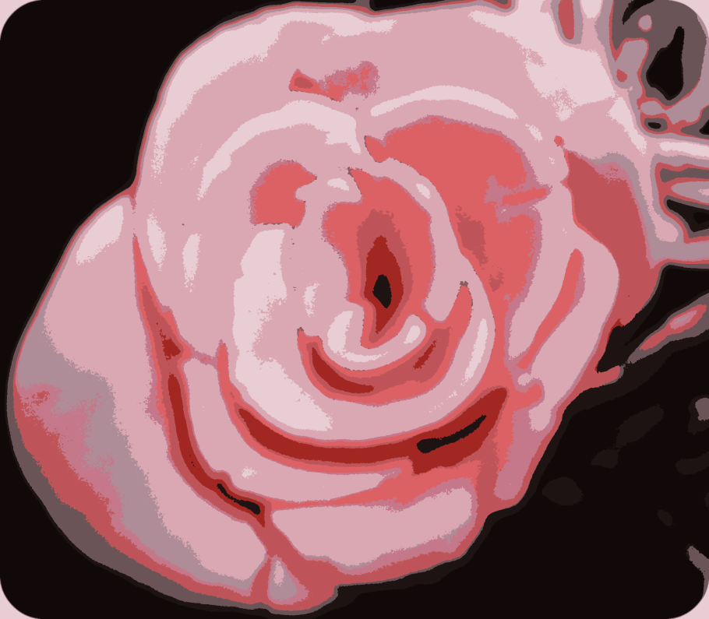
Independent Investigation
Incorporates chemistry and modern art.
Sugar manipulated to create 3D models of roses.
Rose extract used as dye.
Abstract sculpture was created from them.
SCIENCE CAN BE USED TO CREATE ART!!!

Slide 12
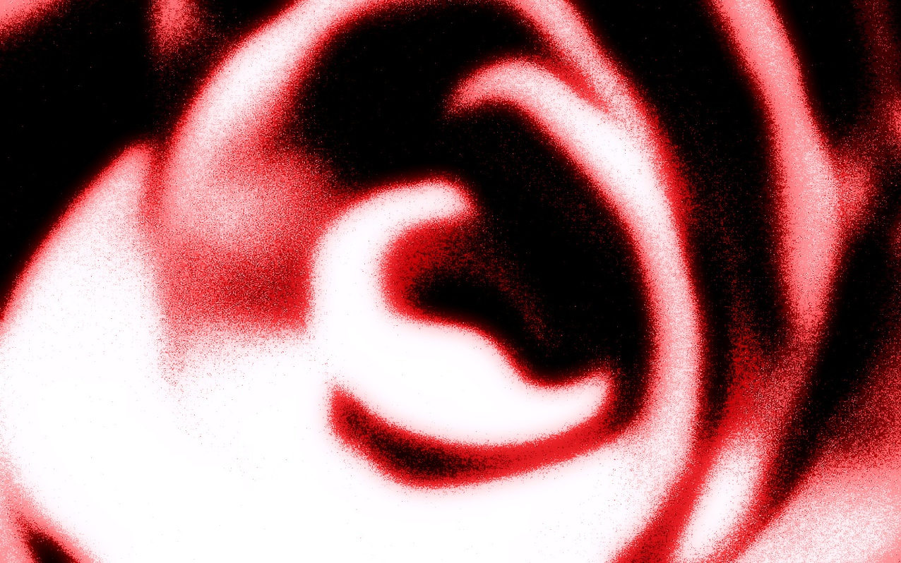
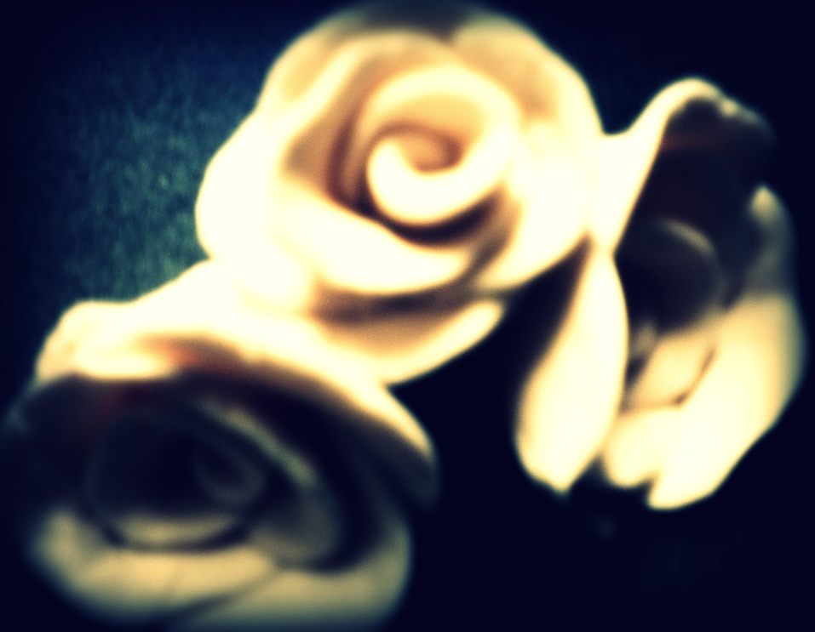
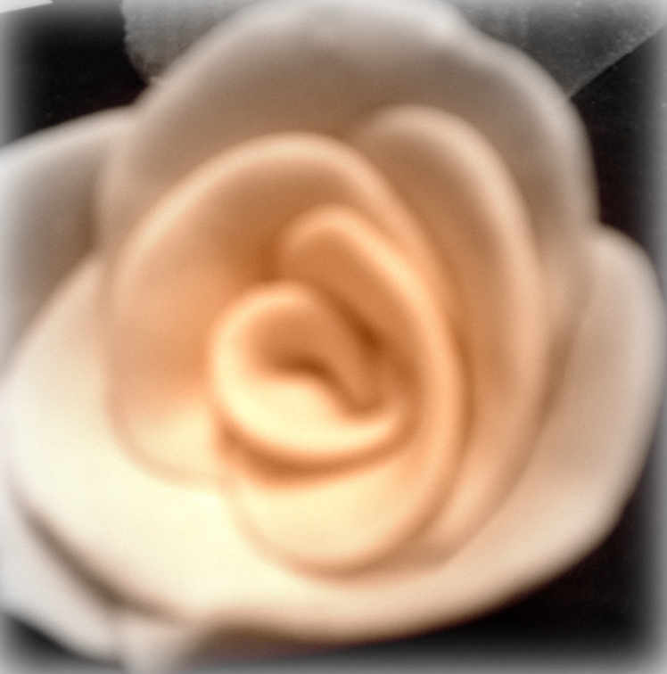
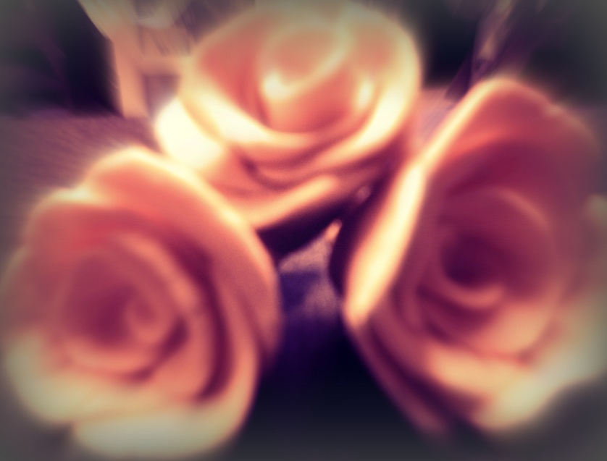
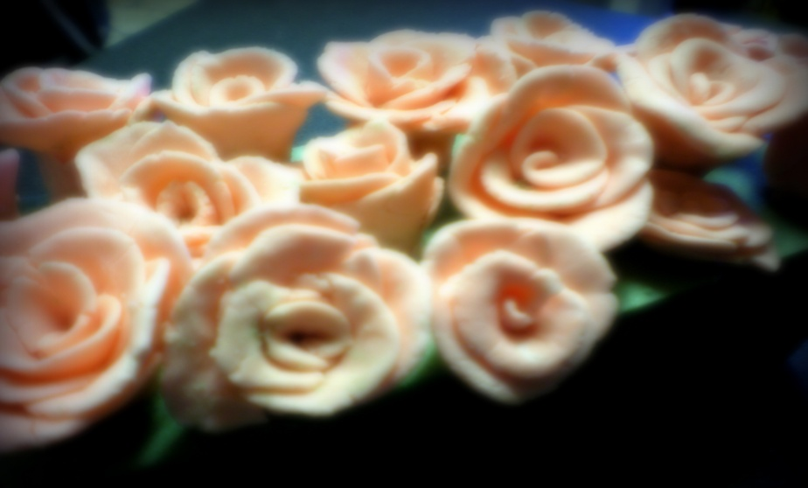
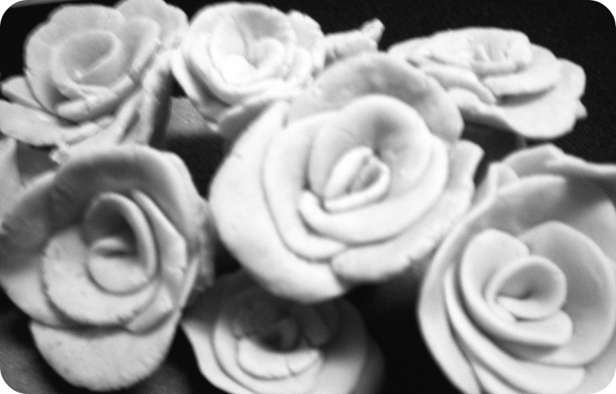
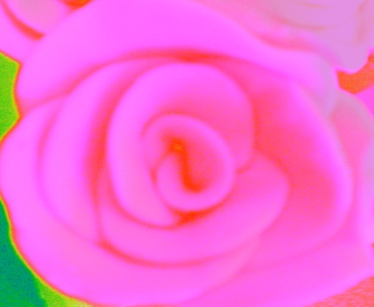

Slide 13
Summary
Anthocyanin: responsible for red, pink pigments in flowers.
Hypothesis: Charleston rose will have ANS, coding for anthocyanin and paint samples found in Parisian art may contain this gene. Rose extract will not contain genetic material.
Methods involve DNA purification from frozen flower tissue
DNA extraction kits used to extract DNA from roses
When amplified during PCR, used in gel electrophoresis
Independent Investigation
Fondant manipulated to make roses
Pictures taken and manipulated to create art
Rose extract purified and used in PCR to find gene

Slide 14
Summary Continued
After DNA extraction and purification
Target DNA amplified, run in gel electrophoresis.
Band at 696bp using 1Kb MW ladder
Paint samples taken from Parisian street artists will be analyzed using PCR, compared to previous gels
Bands same size: natural components used in paints have ANS
Bands not same size: genetic material present
ANS still present, different species of plant used, different location.
Degredation of samples→ 2 out of 3 highly processed.
No bands: paint synthetic
If bands are present, hypothesis is validated.
We are continuing to research and understand genetics.
Still a work in progress, but we have a clear plan

Slide 15
Future Directions
Restriction Enzyme Digest
Known: band 696bp and sequence of amplified DNA
Using restriction enzyme, we can predict exactly where enzyme will cut and how many fragments should result.
Gel will either support or refute identity of band
No specific enzyme chosen yet, still in planning stages

Slide 16
References
Brand, D.J. 2007. Structure and synthesis of bioactive polyphenols from Cyclopia Subternata (Honeybush) and Aspalathus Linearis (Rooibus) tea: Conformational analysis of selected chiral derivatives. Ph.D. thesis. University of the Free State Bloemfontein.
Bonczyk et al. 2009. Genotypic Identification of CF Patients with the R553X Mutation using IB3 and S9 Cell Lines and Allele Specific PCR. LB 145 Course Pack. MSU Printing Services, East Fee Hall. Michigan State University, East Lansing, MI.
Campbell, N.A. and Reese J.B. 2007. Biology-8th Ed., Chapter 13 “Mendel and the Gene”. Benjamin Cummings, CA.
Chiou, C., K. Wu, K. Weh. 2008. Characterization and promoter activity of chromoplast specific carotenoid associated gene (CHRC) from Oncidium Gower Ramsey. Biotechnol Lett 30:1861-1866.
Chiou, C.Y. and K. Yeh. 2008. Differential expression of MYB gene (OgMYB1) determines color patterning in floral tissue of Oncidium Gower Ramsey. Plant Molecular Biology 66: 379-388.
Dela, et al. 2003. Changes in anthocyanin concentration and composition in ‘Jaguar’ rose ﬂowers due to transient high-temperature conditions. Plant Science, 164, Retrieved October 3, 2009.
Haenisch, et al. 2009. LB145 Course Pack. MSU Printing Services, East Fee Hall. Michigan State University, East Lansing, MI.
Hennayake. C.K. M. Kanechi, Y. Uno, N. Inagaki. 2007. Differential Expression of Anthocyanin Biosynthetic Genes in ‘Charleston’ Roses. Plant Genetics Resouces. 760:643-667.

Slide 17
References Continued
Jobes, D.V., D.L. Hurley, and L.B. Thien. 1995. Plant DNA isolation: A method to efficiently remove polyphenolics, polysaccharides, and RNA. International Journal of Plant Taxonomy 44: 379-386.
Katsumoto, et al. 2007. Engineering of the Rose Flavonoid Biosynthetic Pathway Successfully Generated Blue-Hued Flowers Accumulating Delphinidin. Plant Cell Physiology. 48.
Lawrence, W.J.C. J.R. Prince, G.M. Robinson, R. Robinson. 1938. A Survey of Anthocyanins. Biochem. 32:106-130.
Levi. M.A.B. I.S. Scarimino, R.J. Poppi, M.G. Trevisan. 2004. Three-way chemometric method study and UV-Vis absorbance for the study of simultaneous degradation of anthocyanins in flowers of the Hibiscus rosa-sinensys species. Talanta. 80.
Mikanagi. Y. M. Yokoi, Y. Ueda, N. Saito. 1995. Flower Flavonol and Anthocyanin Distribution in Subgenus Rosa. Biochemical Systematics and Ecology. 23.
Mizutani, M. 2009. GenBank Entrez Nucleotide Website. http://www.ncbi.nlm.nih.gov/sites/entrez?db=nucleotide, last accessed 10/12/09.
Pascual-Teresa, S. and M.T. Sanchez-Ballesta. 2007. Anthocyanins: from plant to health. Phytochem Rev. 7:281-299
Untergasser. A. and H. Nijveen. 2007. Primer3Plus Website. http://www.bioinformatics.nl/cgi-bin/primer3plus/primer3plus.cgi, Last accessed 10/12/09.
Wehling, B. P. Vandenabeele, L. Moens, R. Klockenkämper, A.V. Bohlen, G.V. Hooydonk, M.D. Reu. 1999. Investigation of Pigments in Medieval Manuscripts by Micro Raman Spectroscopy and Total Reflection X-Ray Flourescence Spectrometry. Mikrochim. Acta. 130:253-260.

