Slide 1
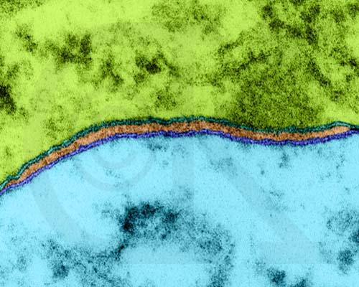
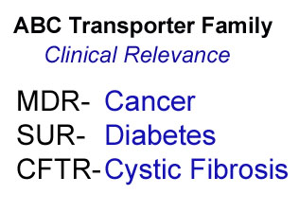
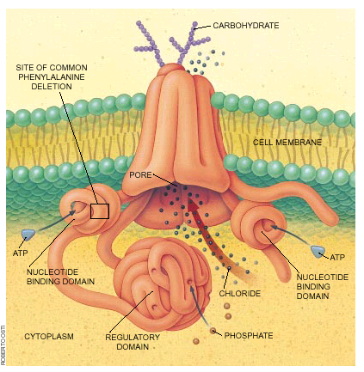
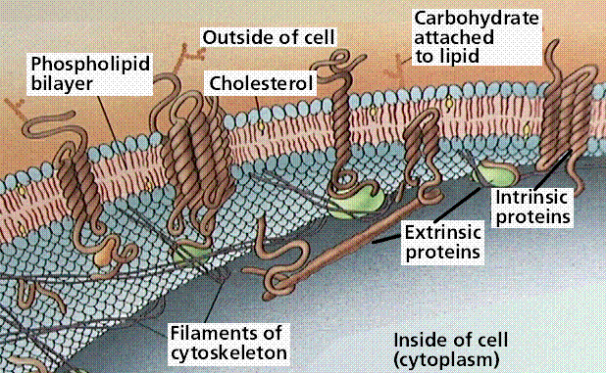

Slide 2
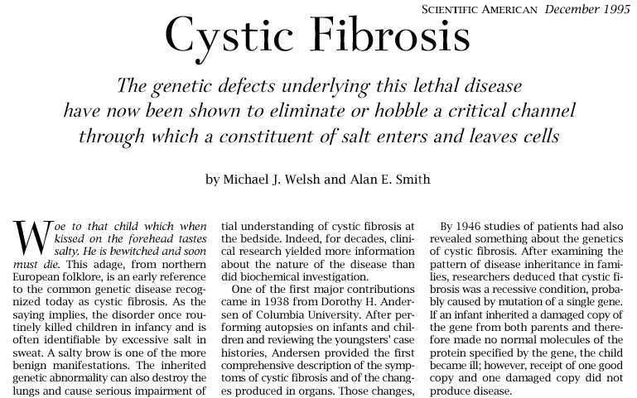
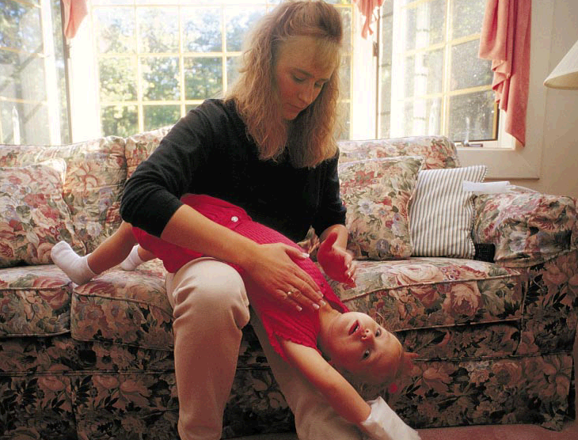

Slide 3
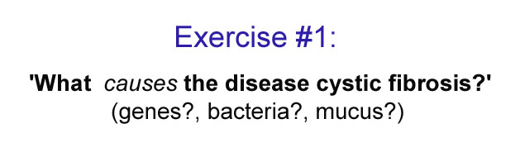

Slide 4
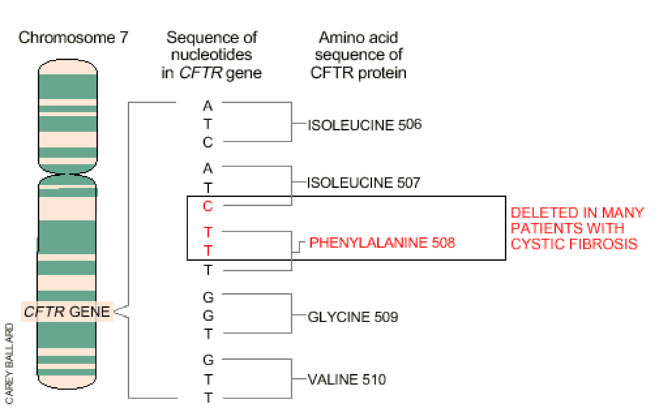

Slide 5
So what do you predict is the problem?

Slide 6
So what do you predict is the problem?
A. The deletion alters gating, thus blocking the CFTR.
B. The deletion alters ATP binding, thus stopping CFTR.
C. The deletion alters the folding, but CFTR still works.
D. None of the above cause the disease.

Slide 7
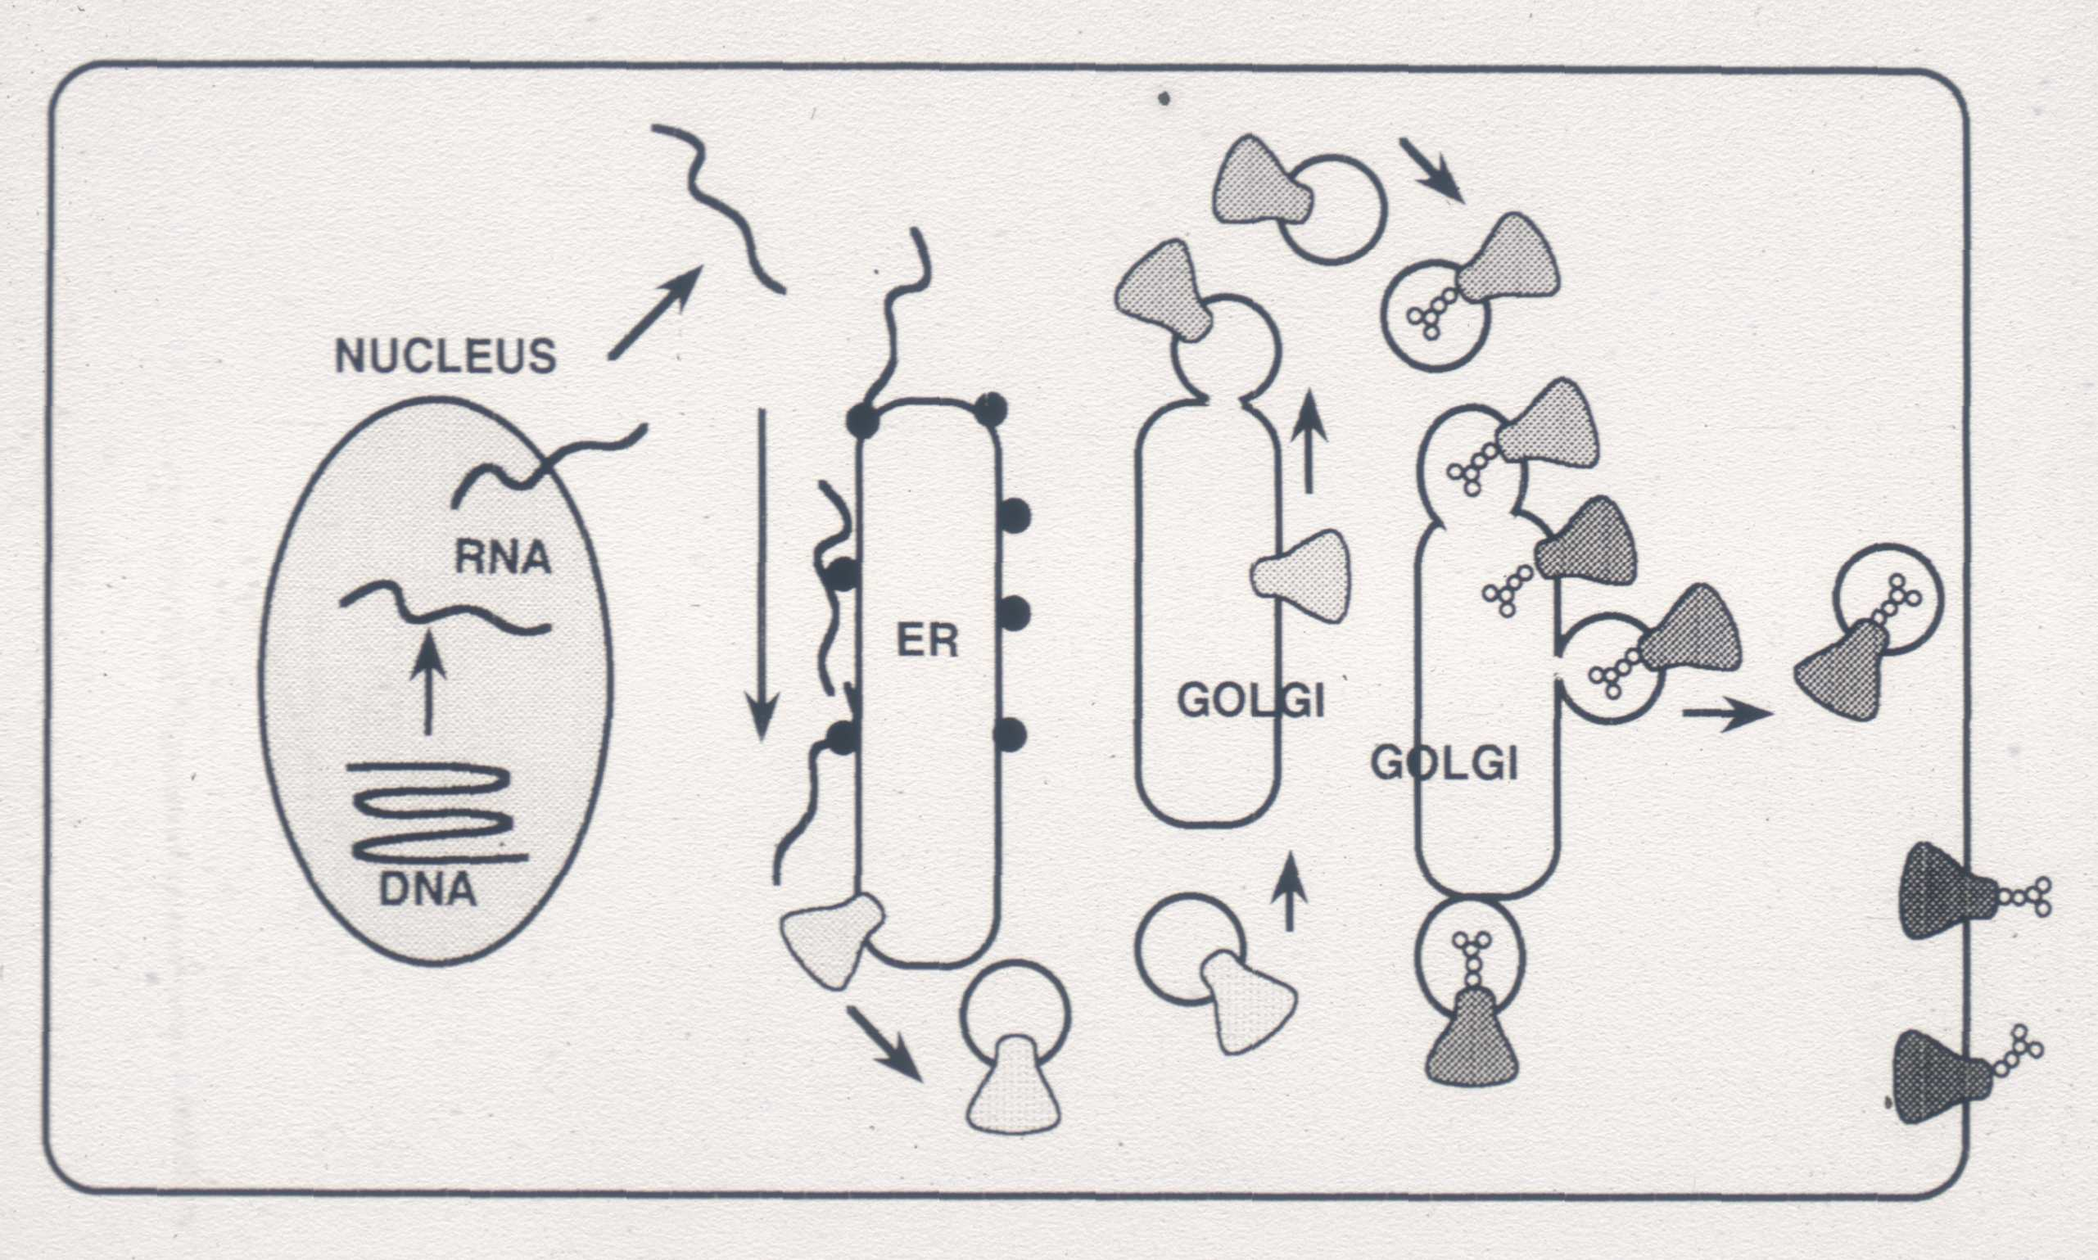
biosynthesis of normal wild-type CFTR

Slide 8
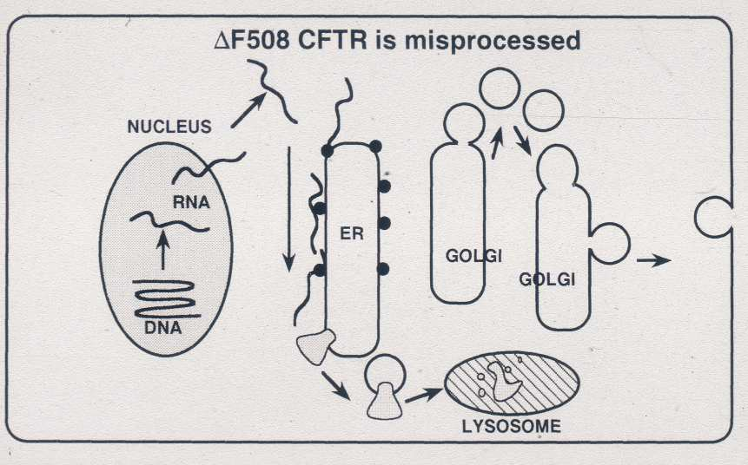
biosynthesis of mutant CFTR
PROTEASOME

